Slide 1

What’s Next?
Matt Bross
Global CTO

Slide 2
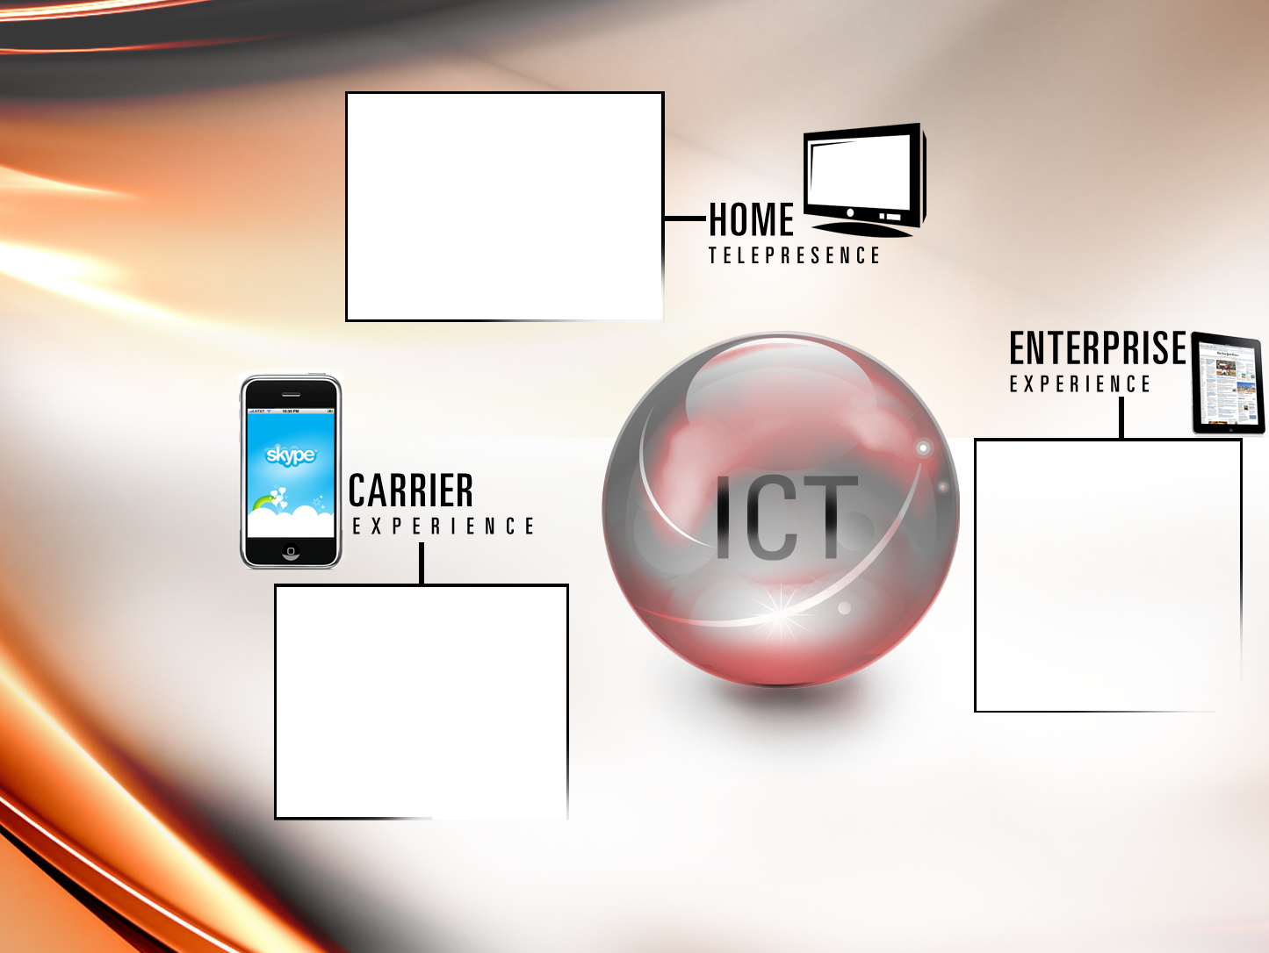
Home users are
Embracing conferencing and collaboration tools
Telepresence and Mobile
Broadband are now consumer offerings
Enterprises are using consumer and OTT technology for business
iPAD, iPOD and Android began as consumer but now are enterprise platforms
Carrier services are
being delivered by consumer companies
SKYPE may become the largest voice provider in the world
ICT EXPERIENCE EXAMPLES
Solutions and Technology are Migrating Between Domains

Slide 3
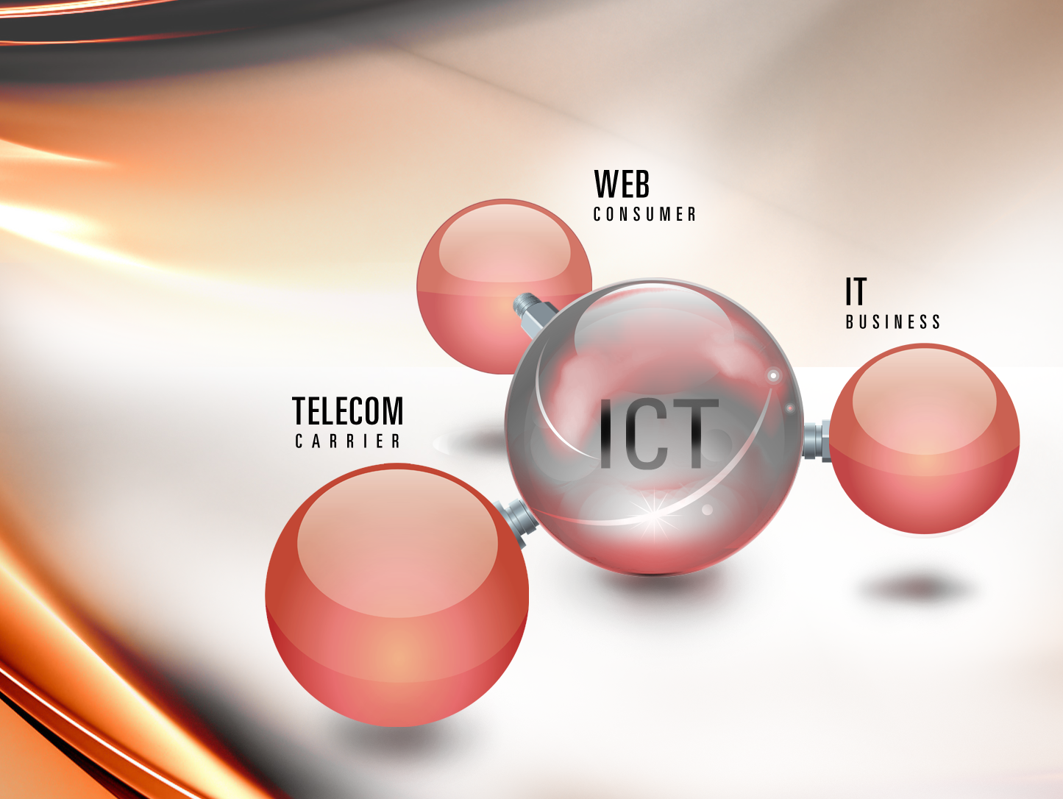
ICT CONVERGENCE
Carrier / Consumer / Enterprise Markets are becoming indistinguishable

Slide 4

Contact Deb Stokes
Deborah.Stokes@Huawei.com
972.365.4659

