Slide 1
The Future of the Future
Can Chinese foreign policy change world social and economic development through advanced telecommunicastions?

Slide 2
Development
Telecommunications is development
China is beloved in Africa, 55 countries
China provides turn-key solutions
India plays no role outside of India
The USA is consumed by military spending

Slide 3
Education
Long term solution to anything is education
The key is primary education
Two and three shift school
Added need for wireless to be seamless
Need to leverage the kids

Slide 4
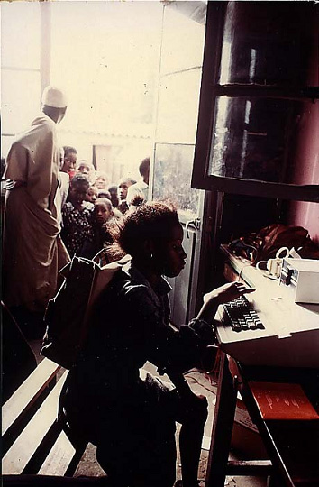
1982

Slide 5
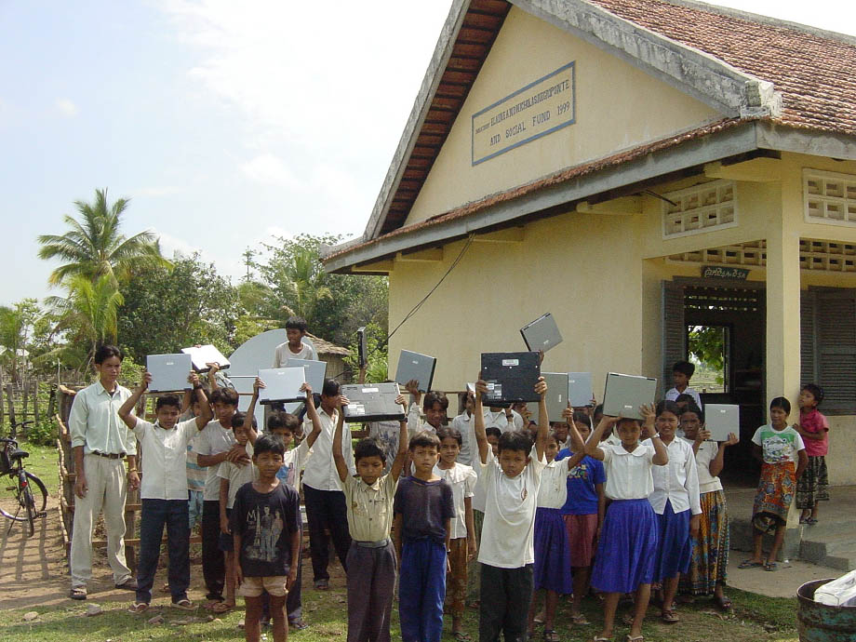
2001

Slide 9
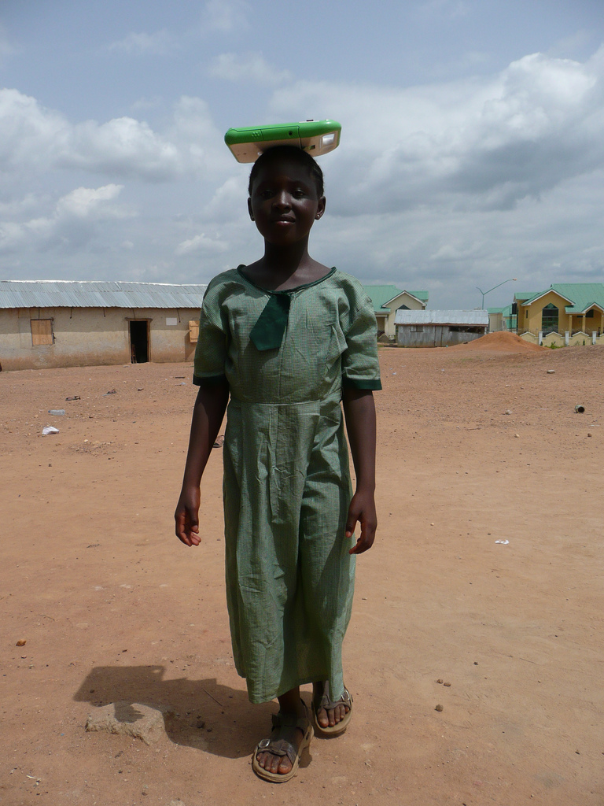

Slide 10
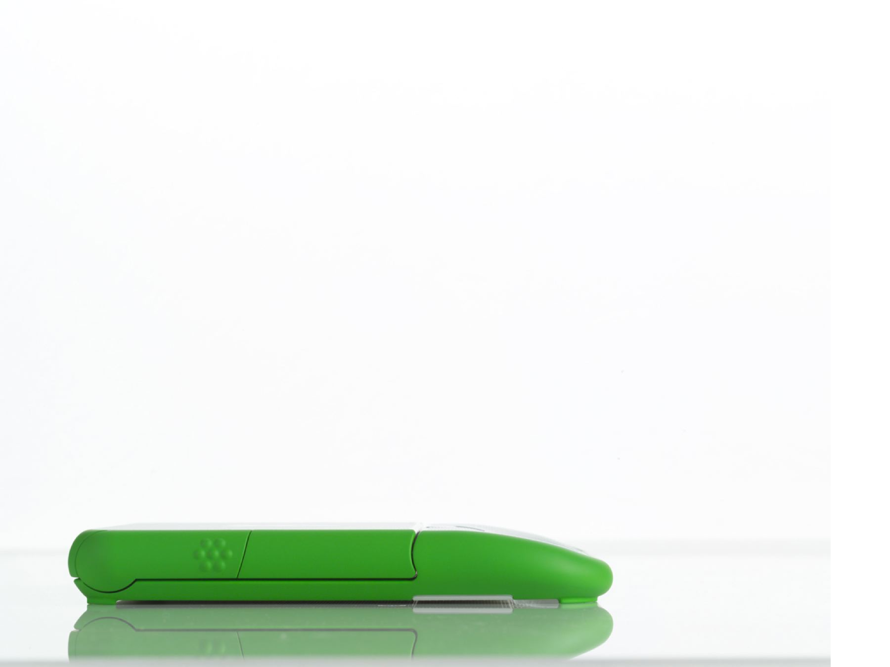

Slide 11
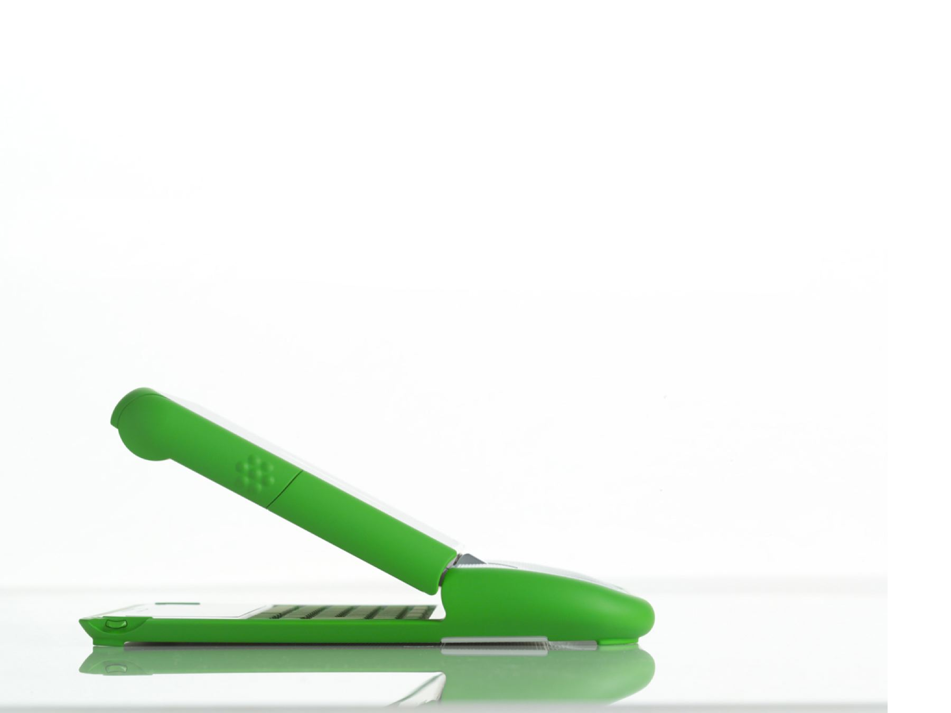

Slide 12
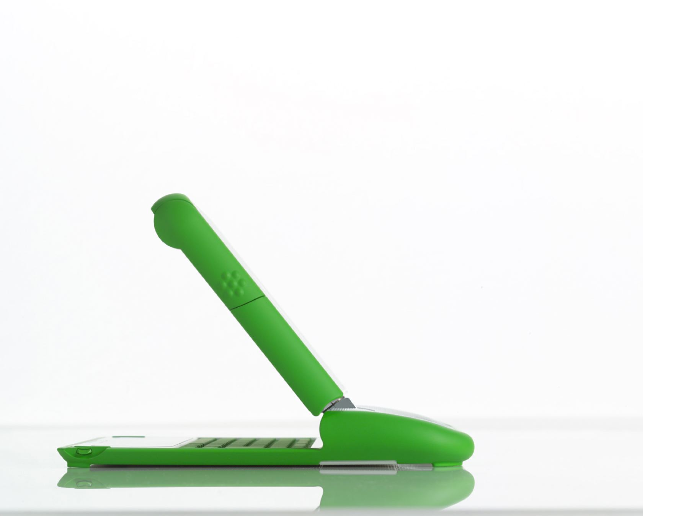

Slide 13
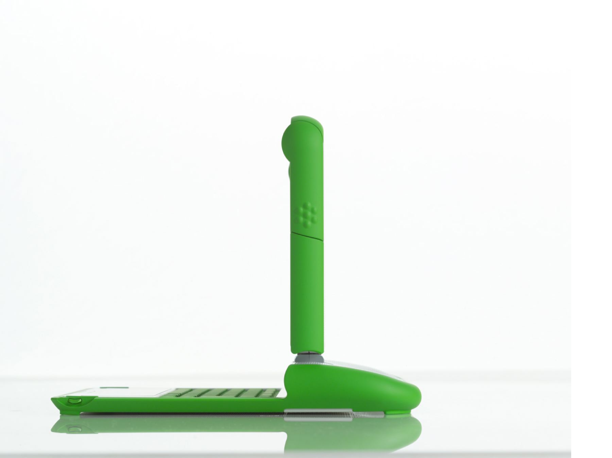

Slide 14
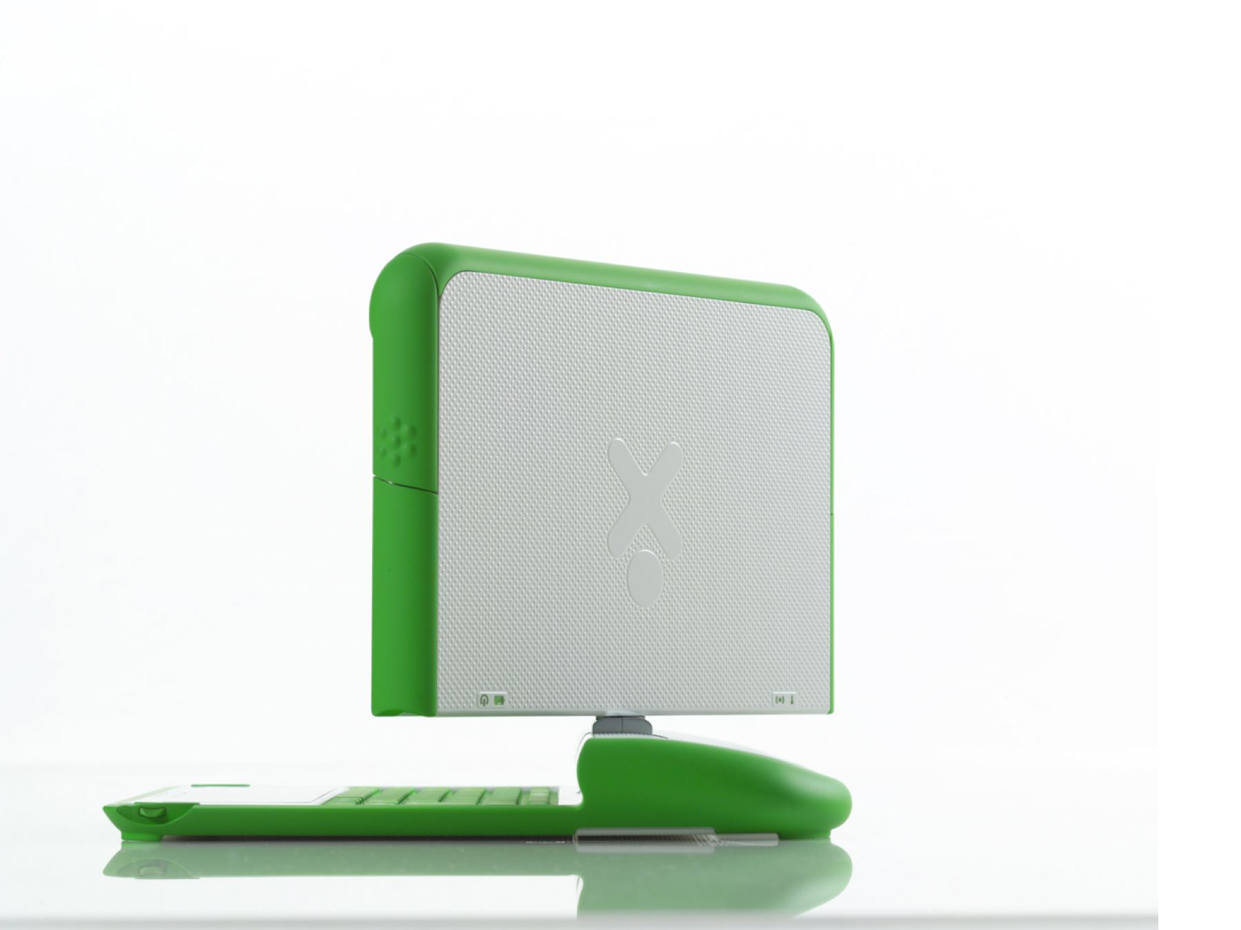

Slide 15
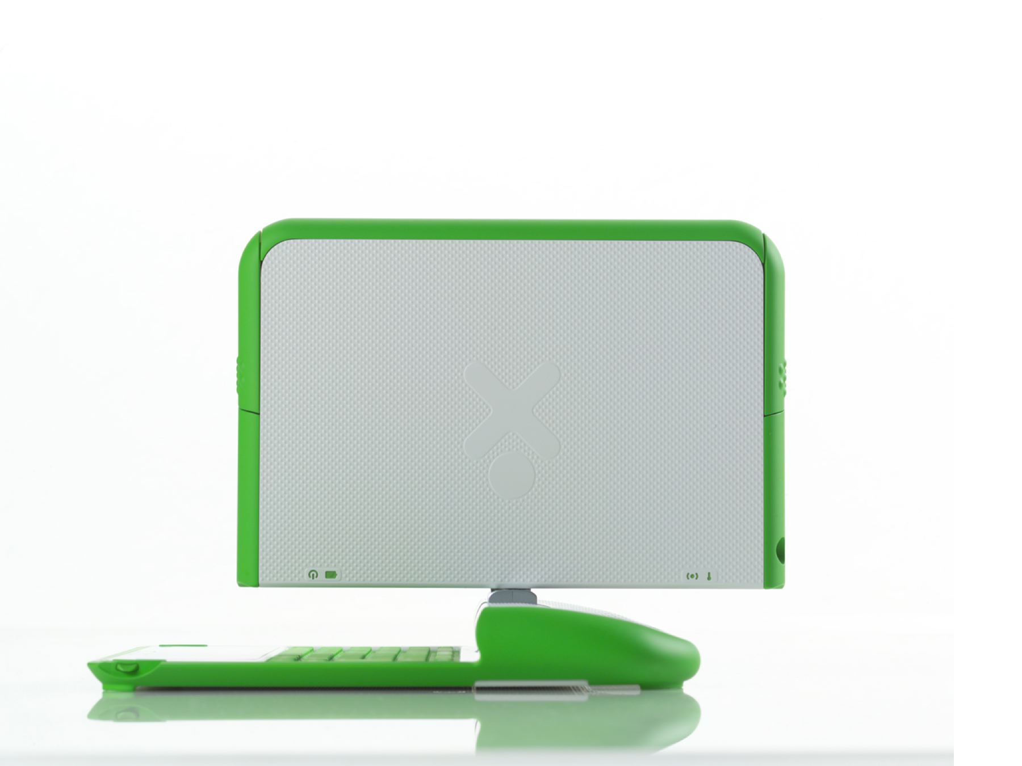

Slide 16
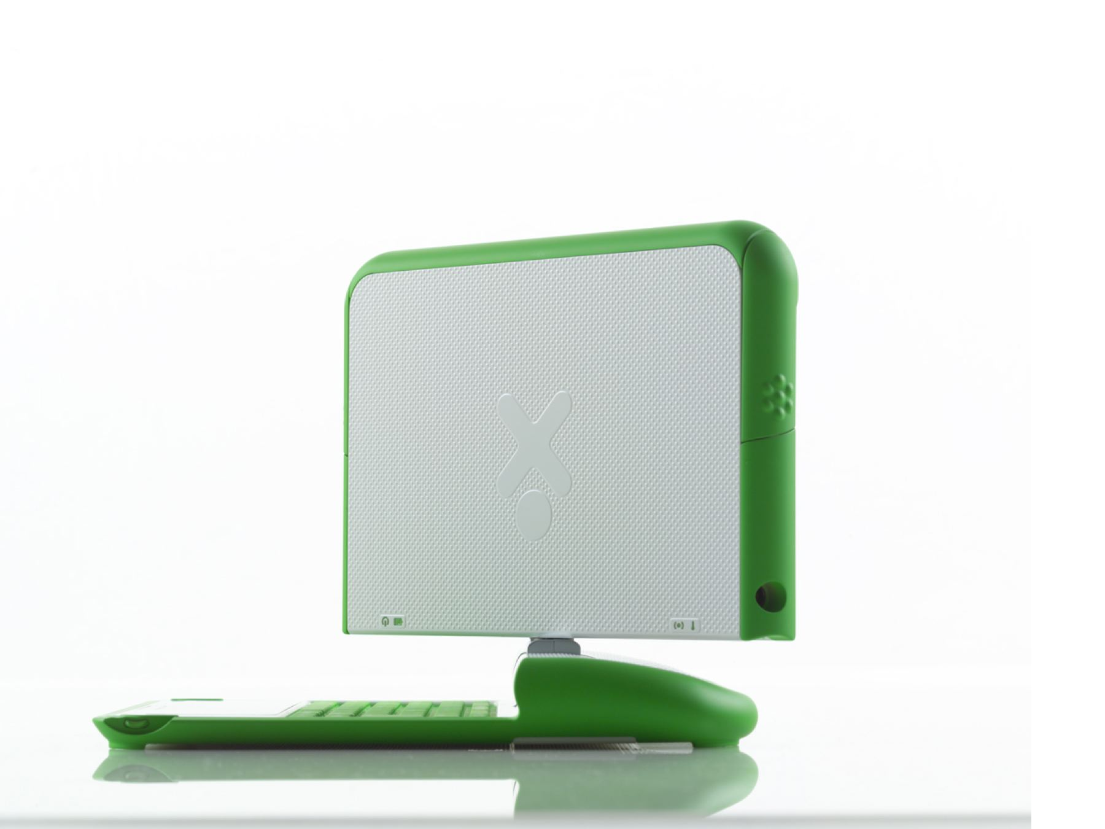

Slide 17
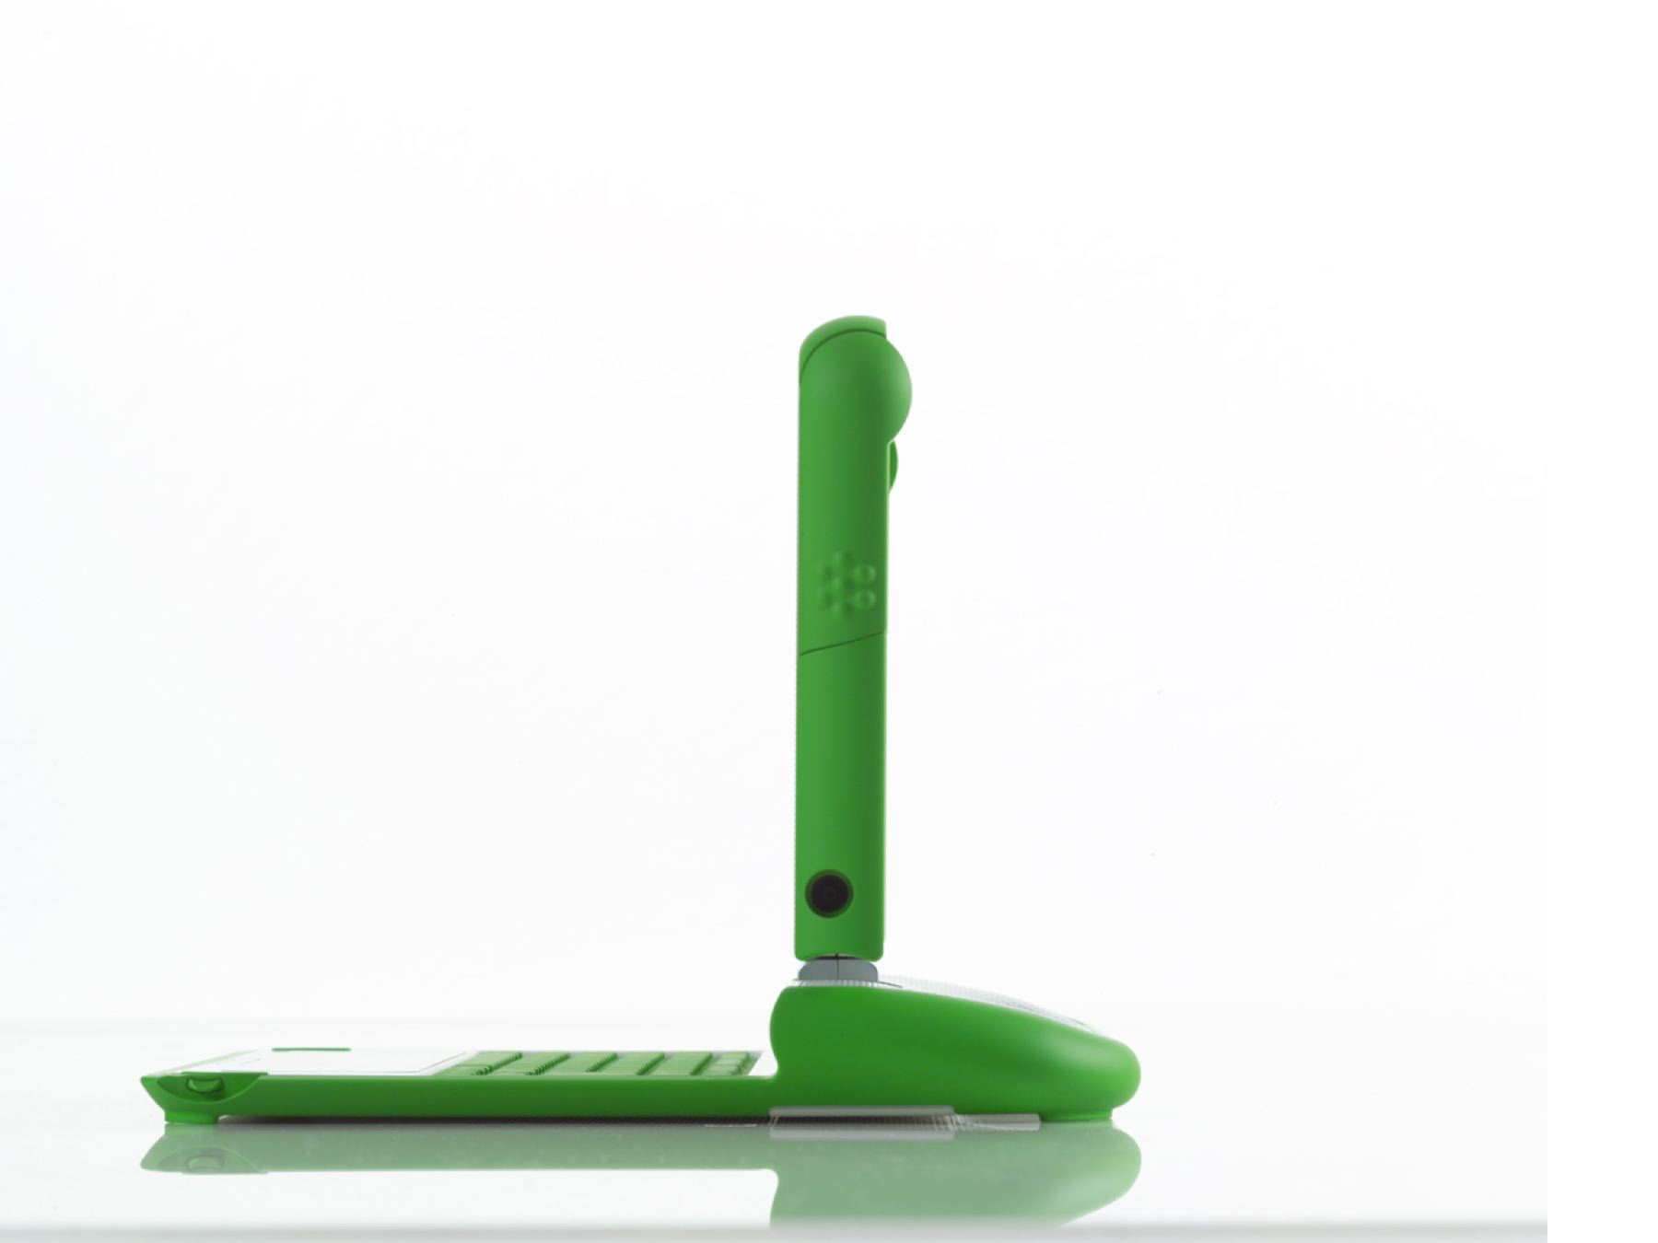

Slide 18
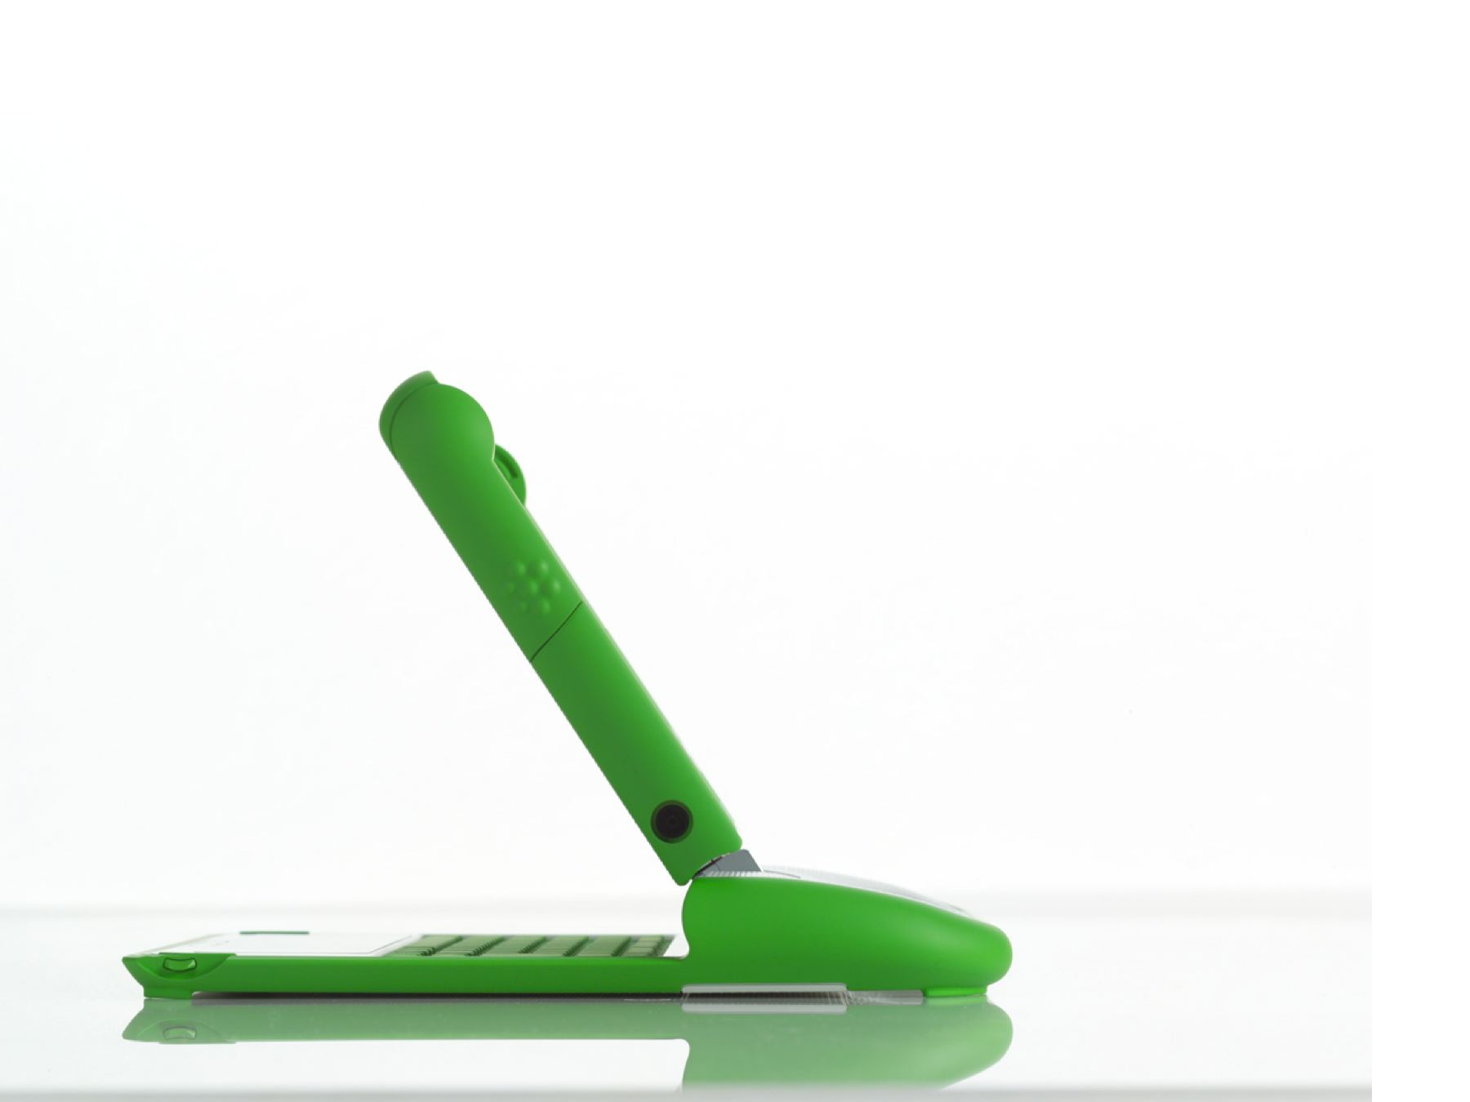

Slide 19
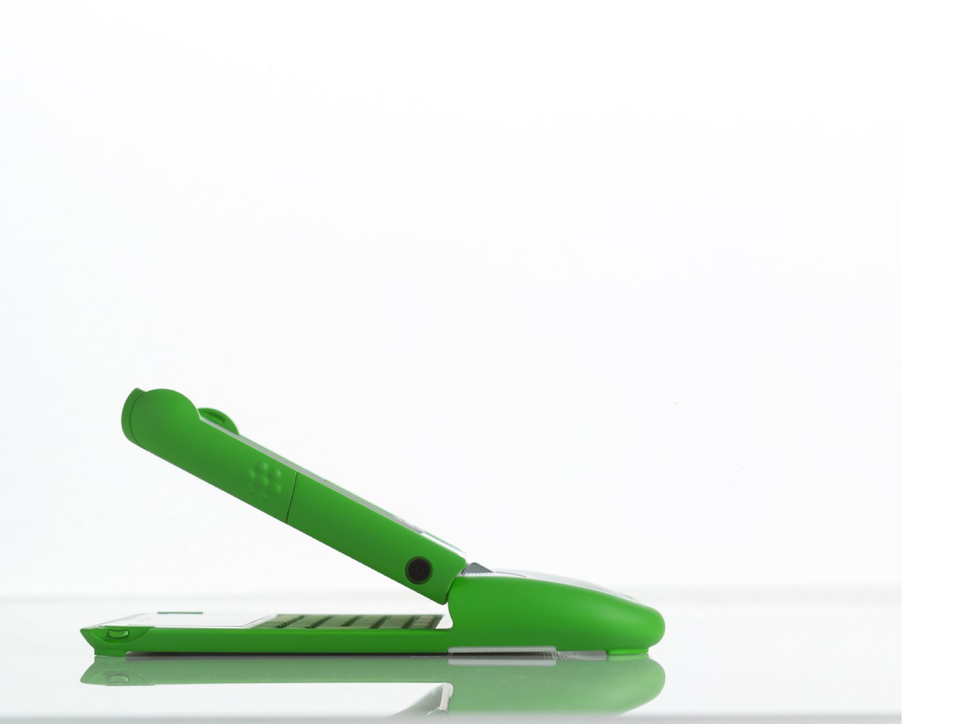

Slide 20
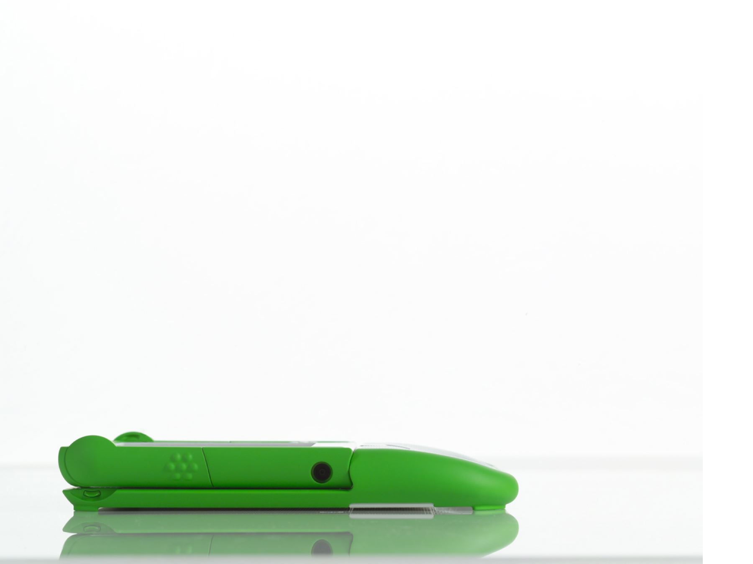

Slide 22
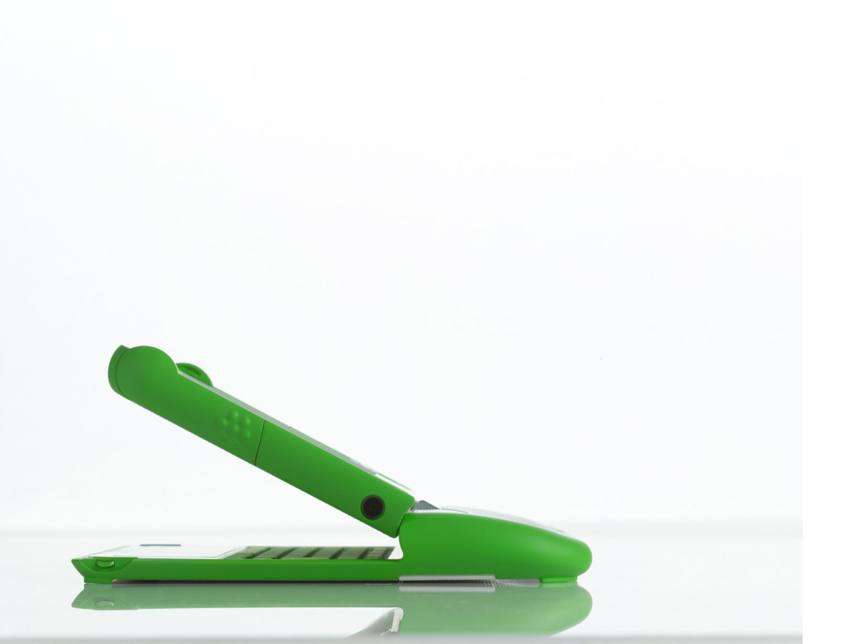

Slide 23
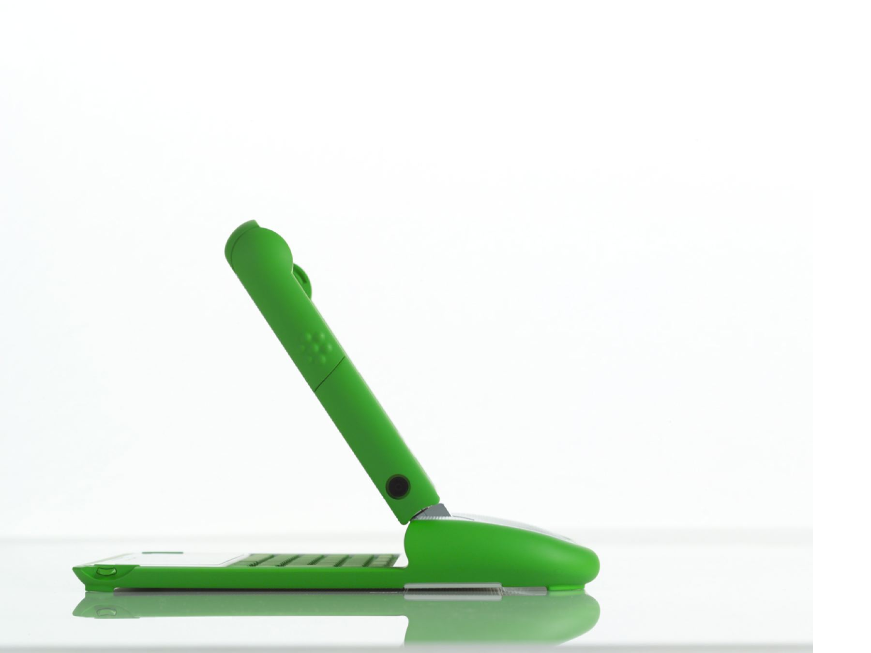

Slide 24
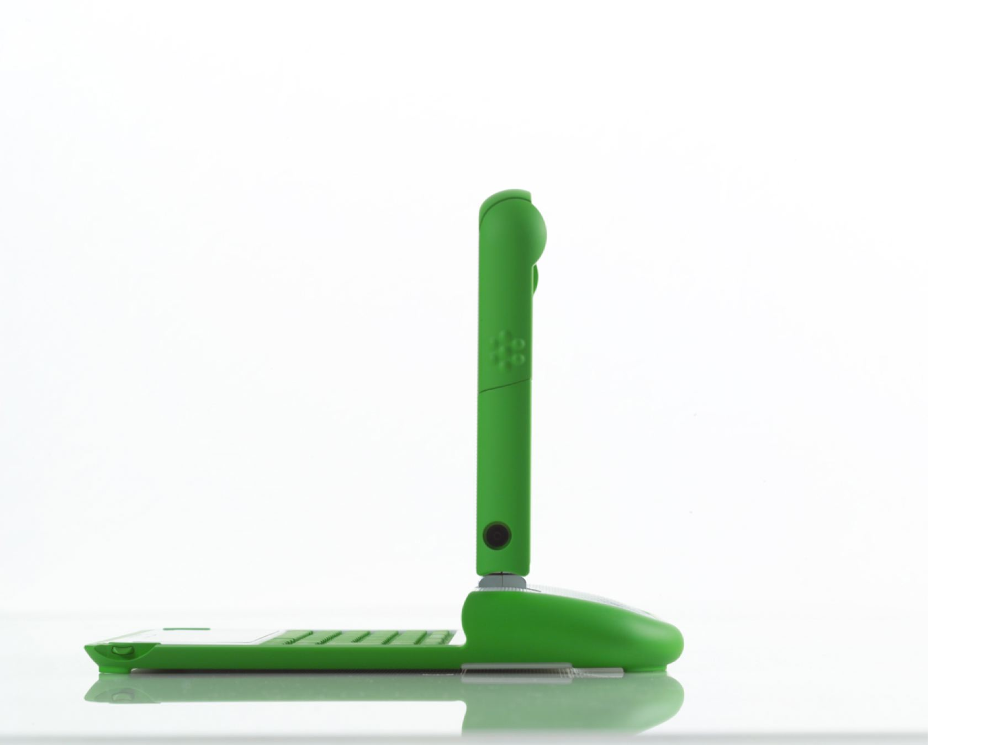

Slide 25
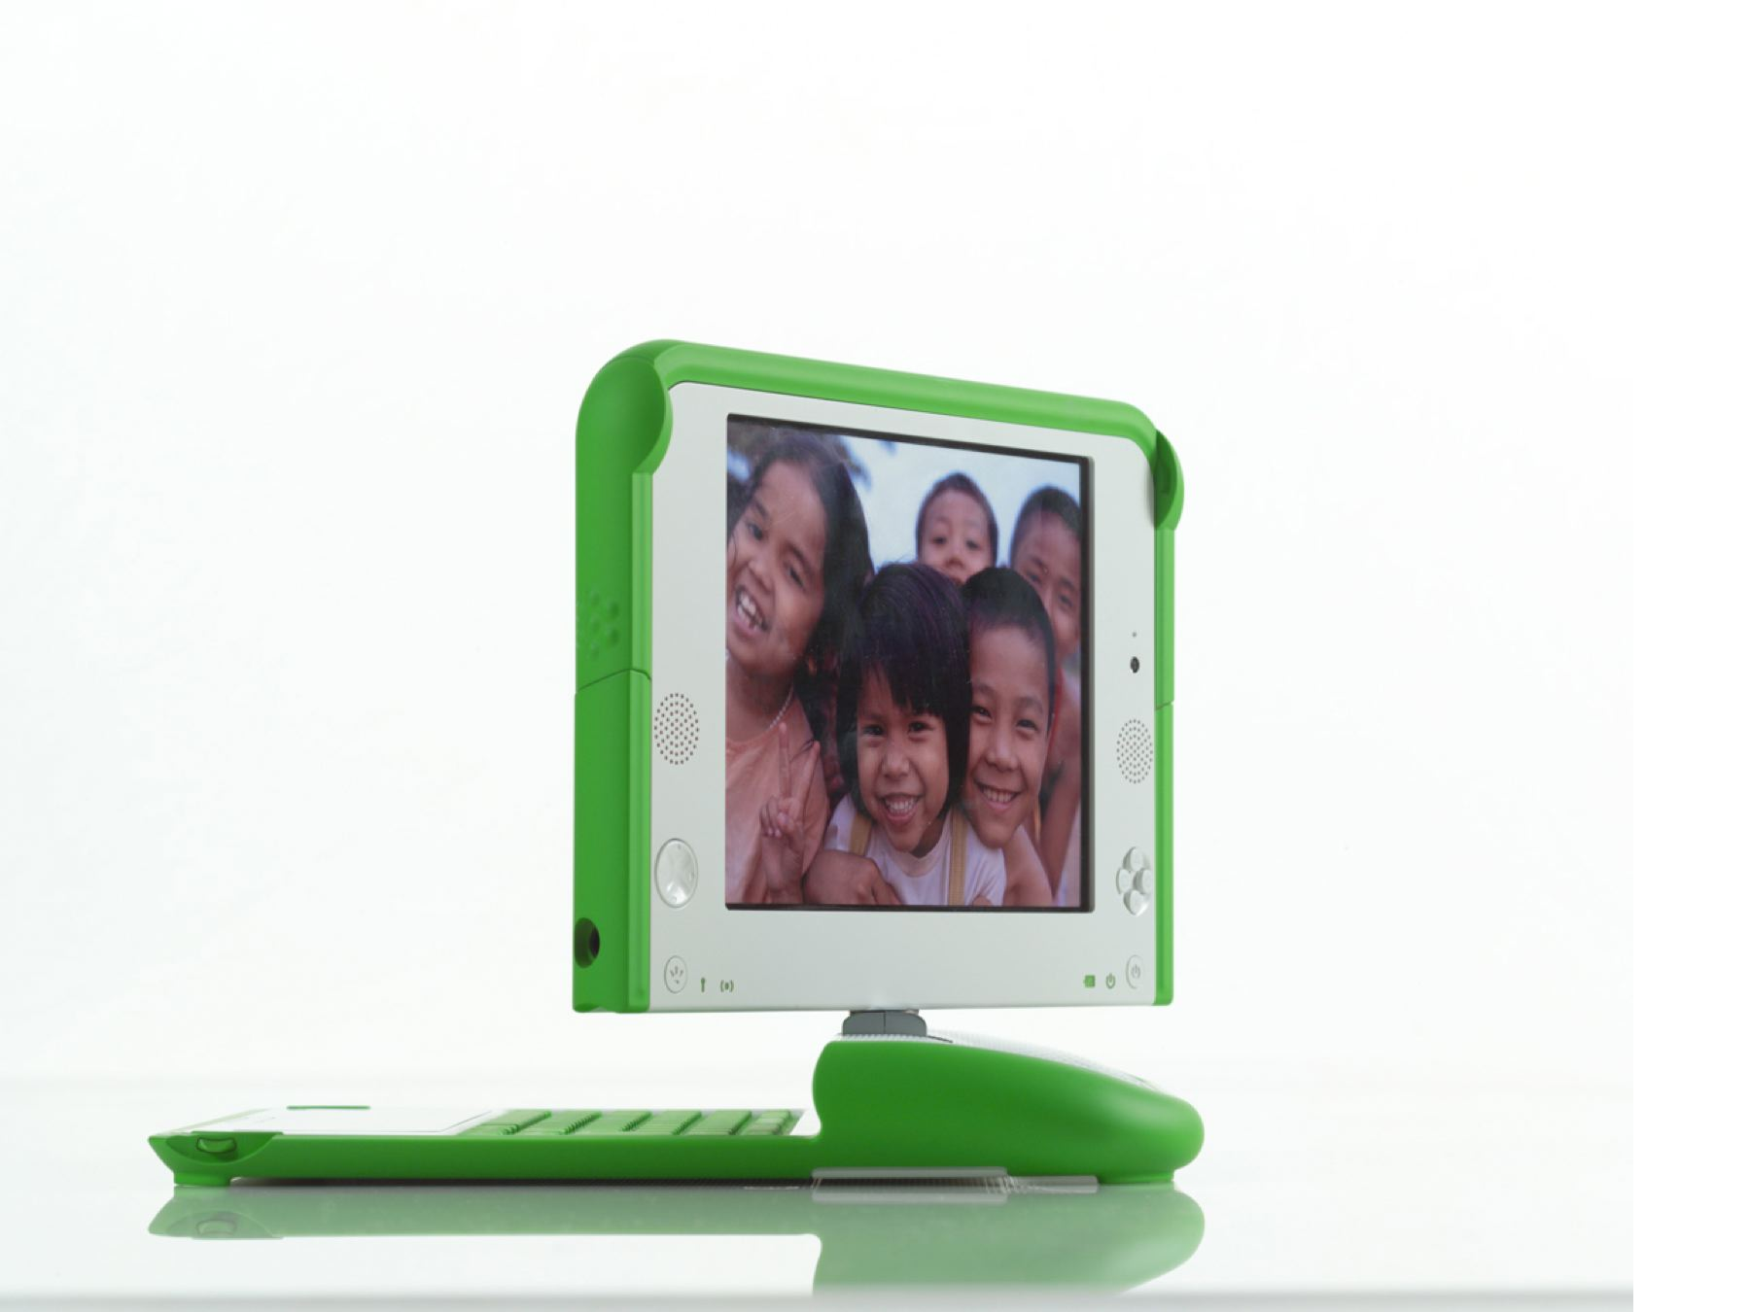

Slide 26
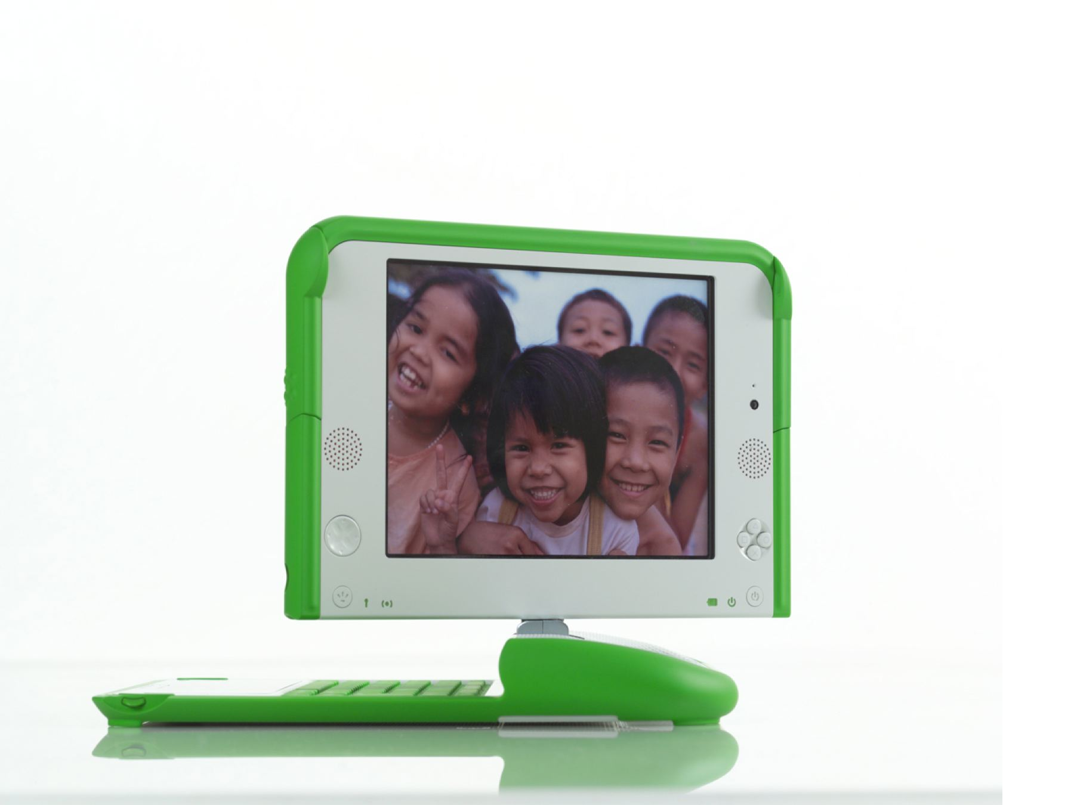

Slide 27
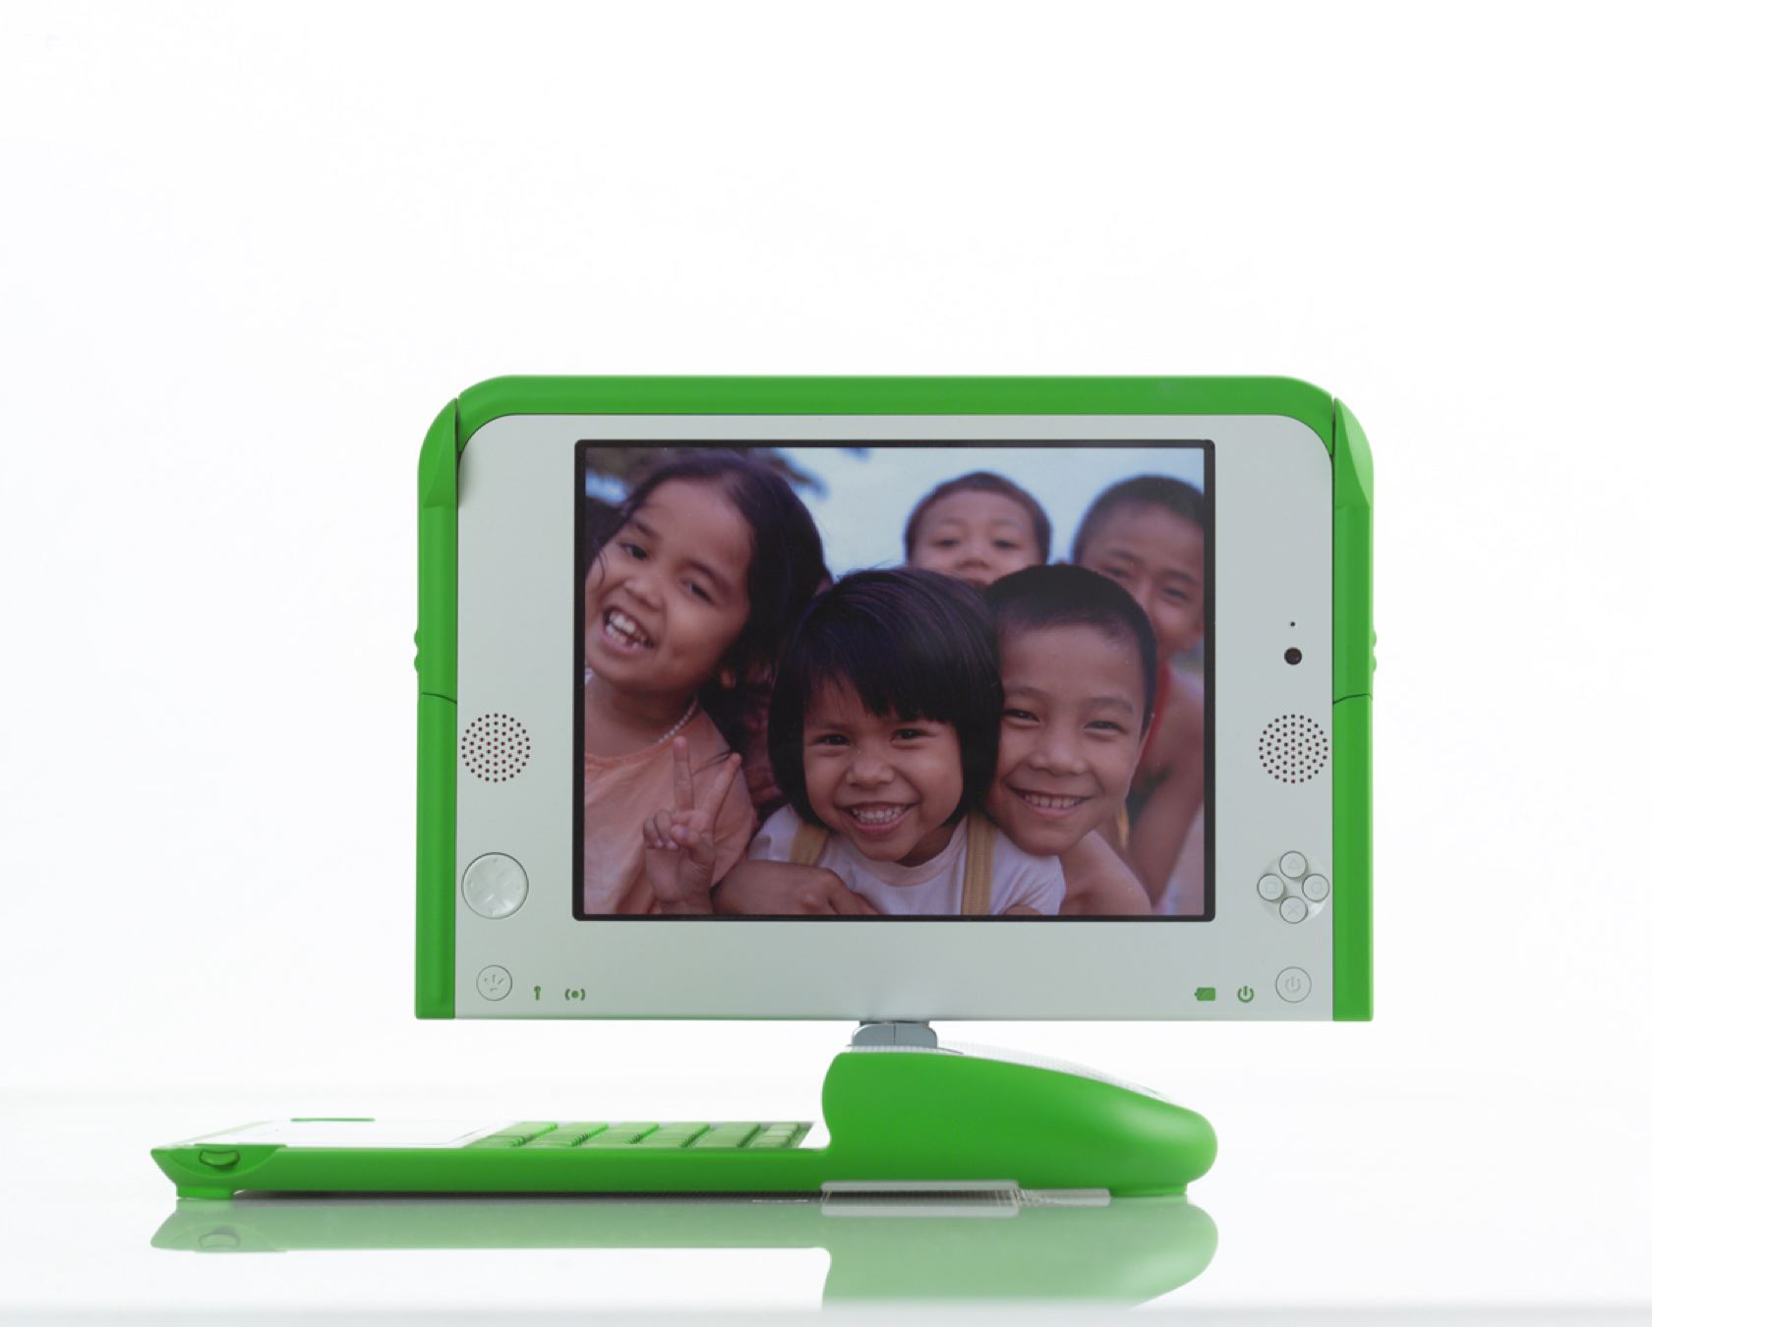

Slide 28
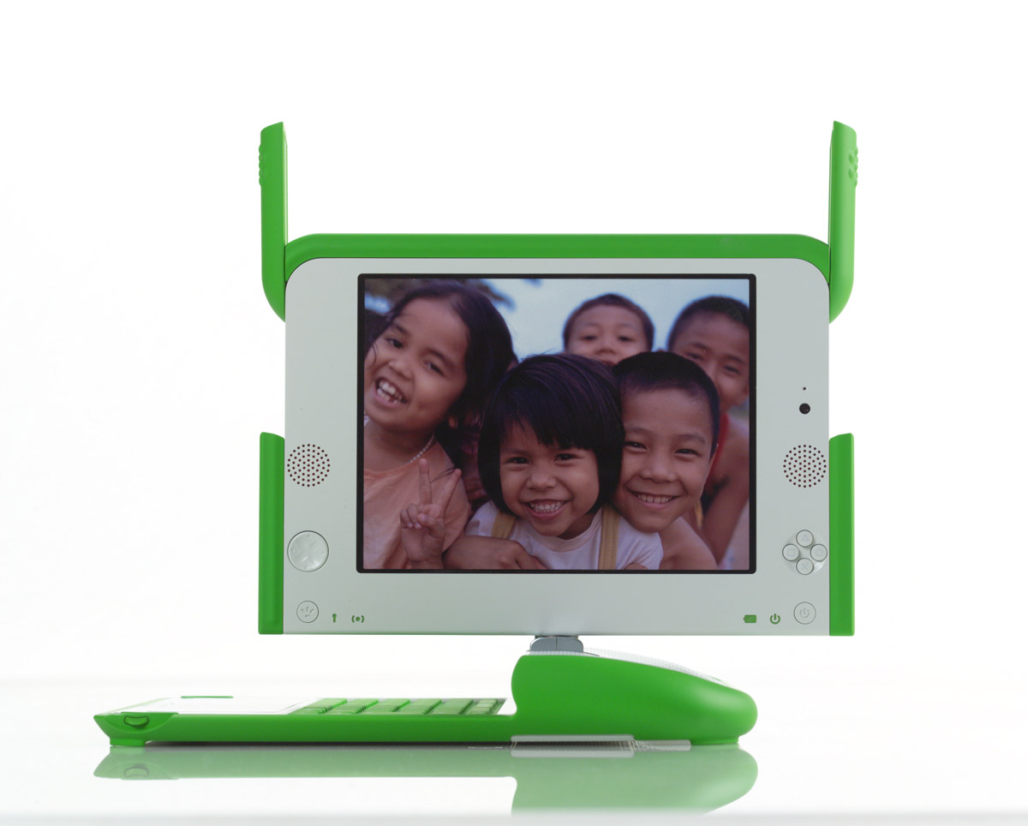

Slide 30
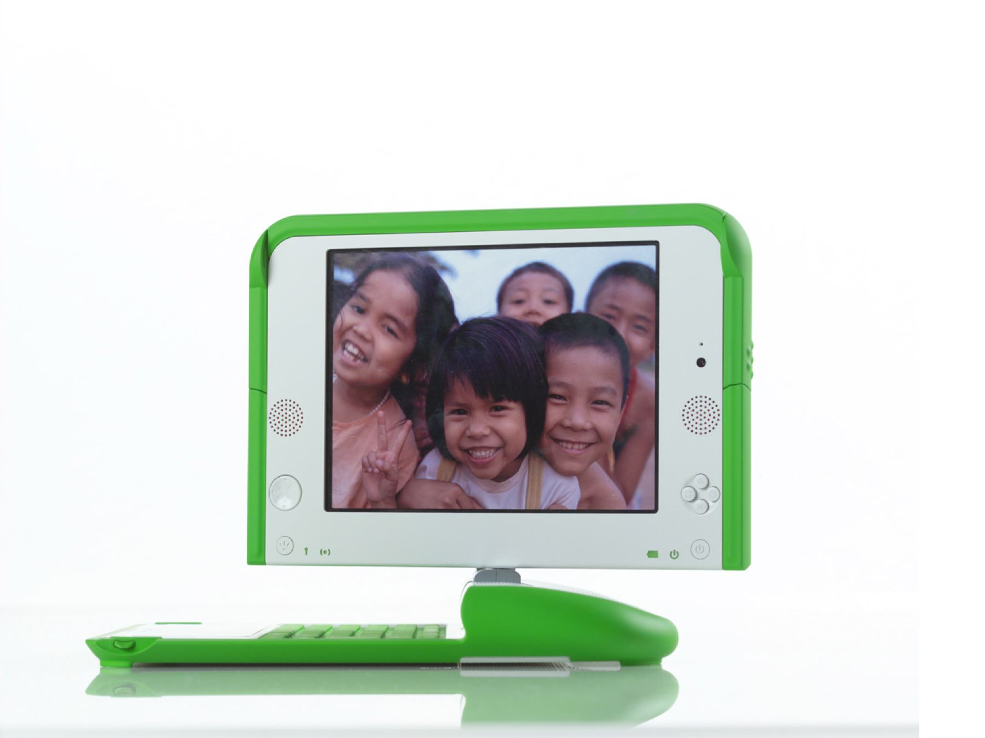

Slide 31
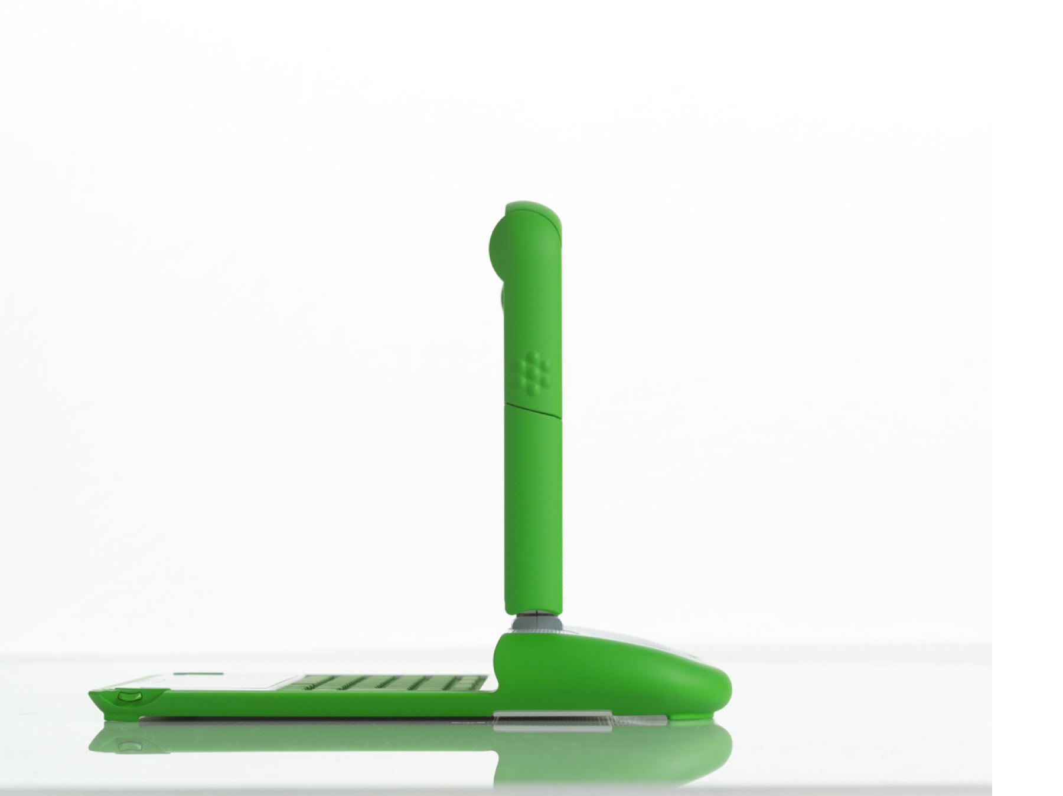

Slide 32
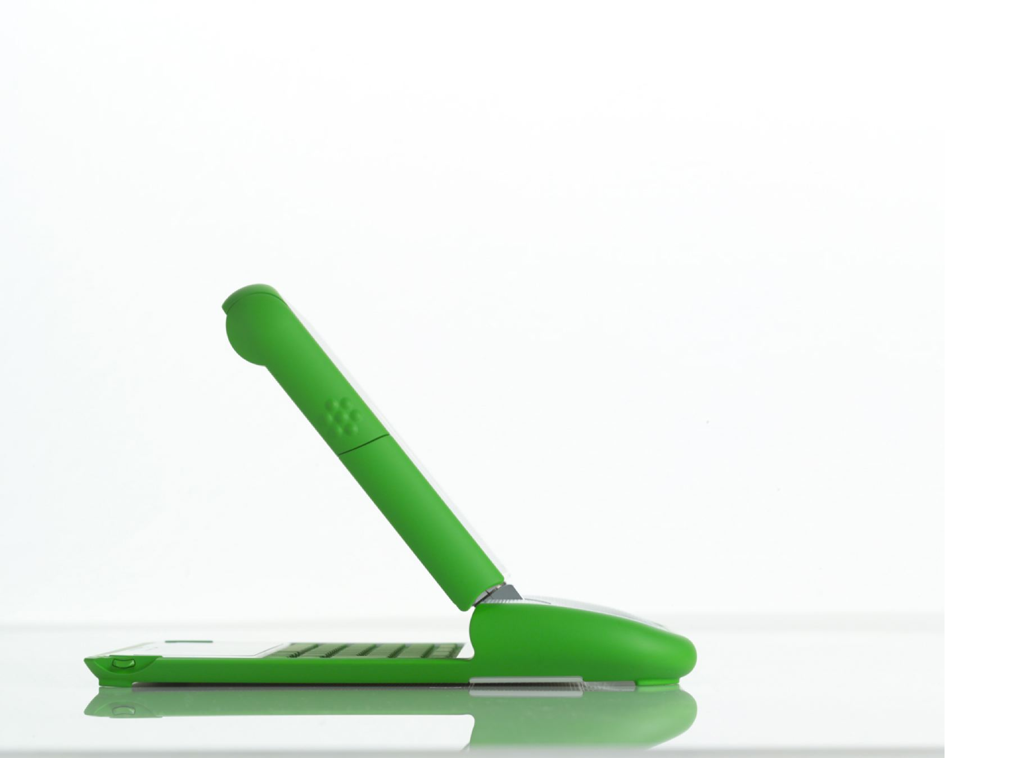

Slide 33
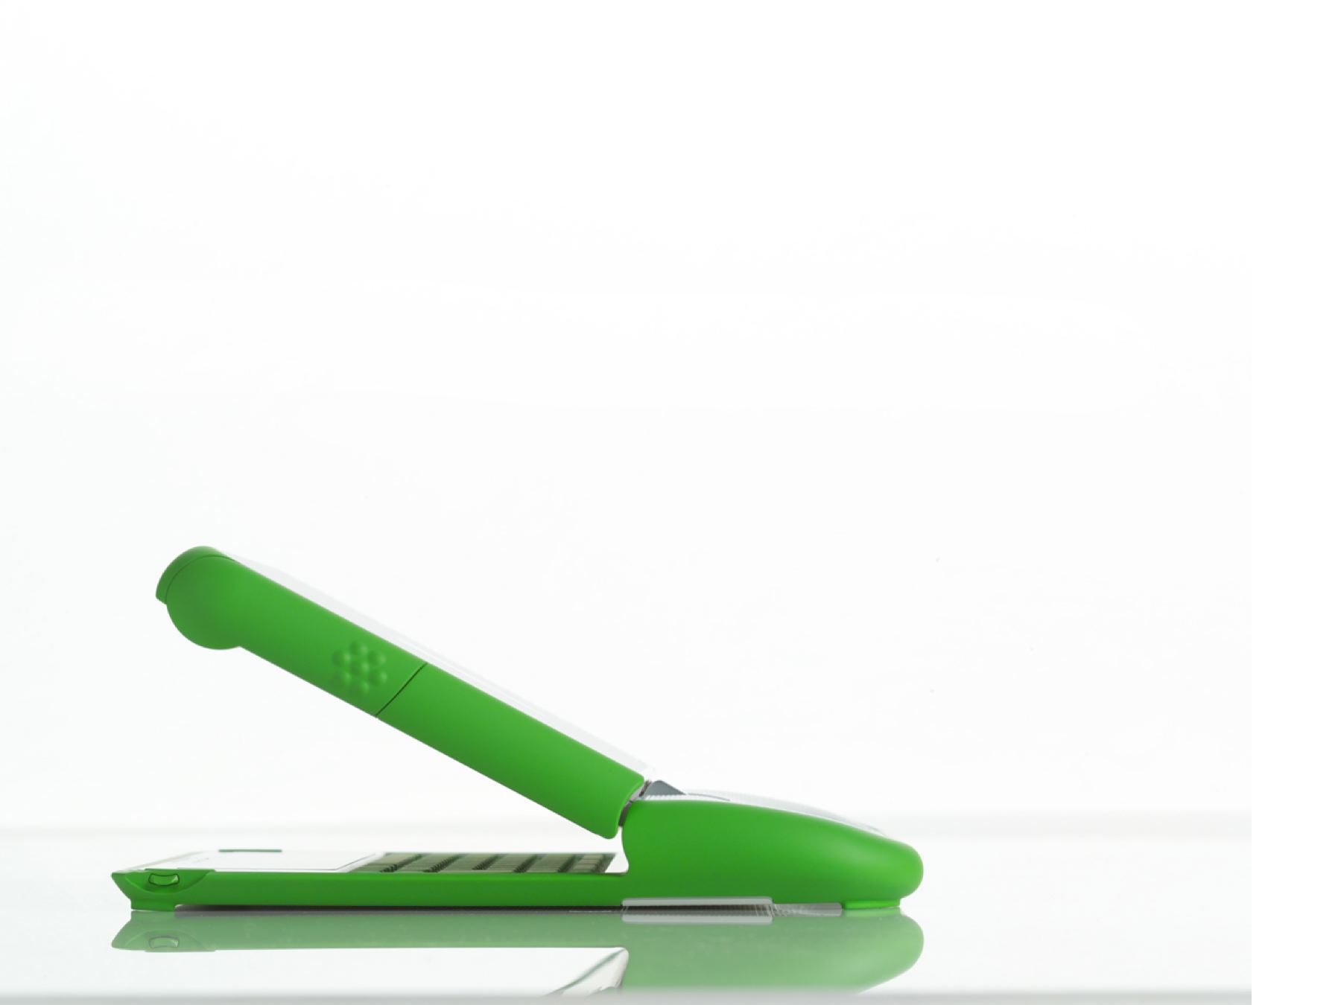

Slide 35
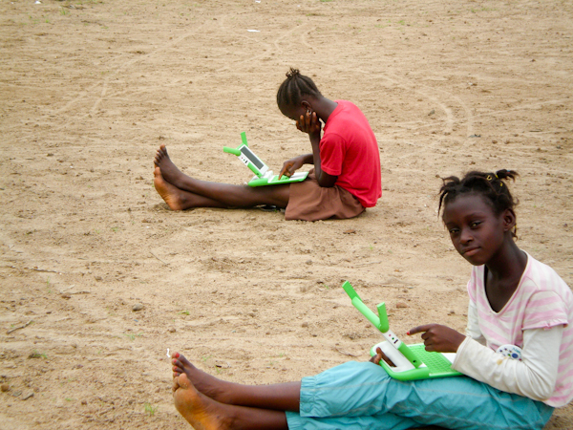

Slide 36
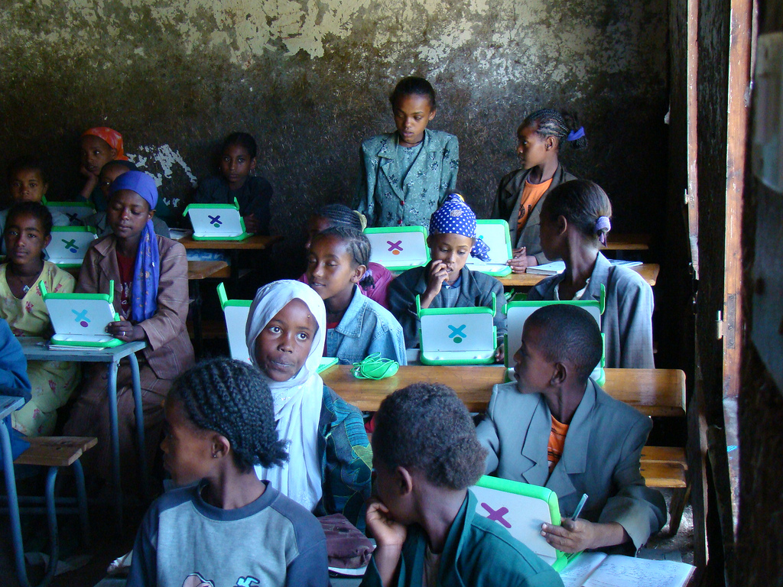

Slide 37
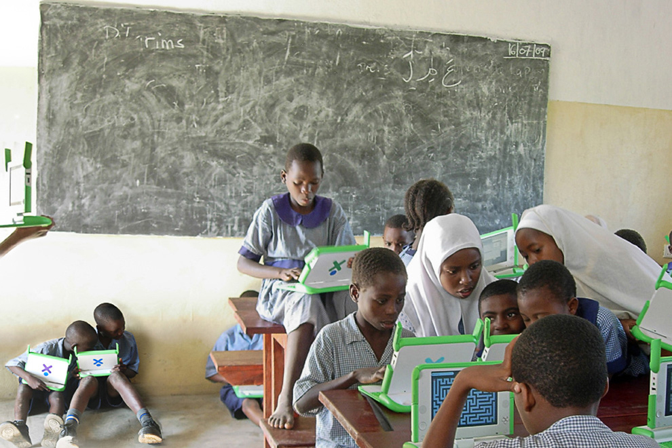

Slide 38
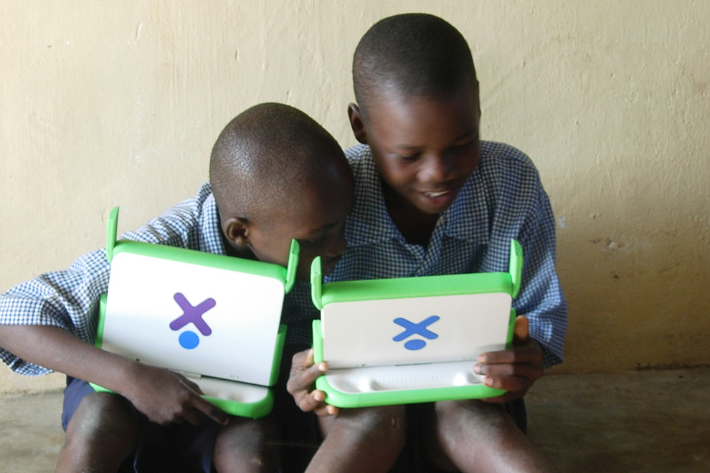

Slide 39
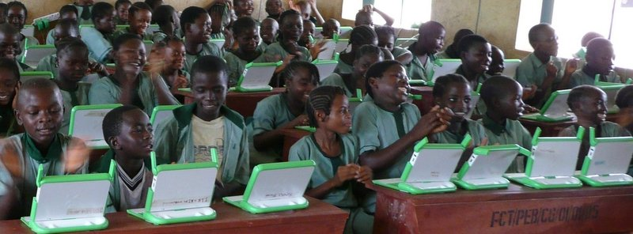

Slide 42
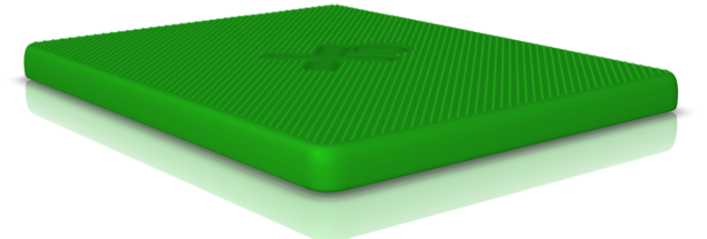

Slide 43
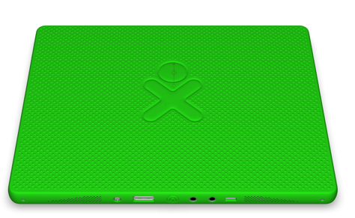
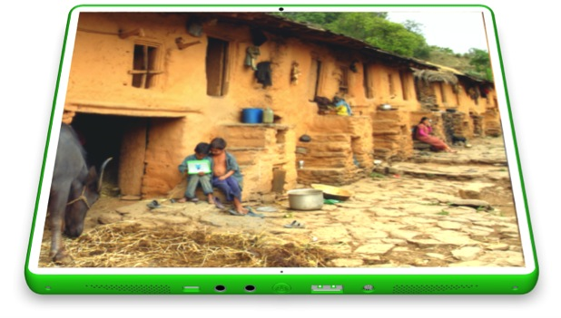
XO Tablet – Top and Bottom Views

Slide 44
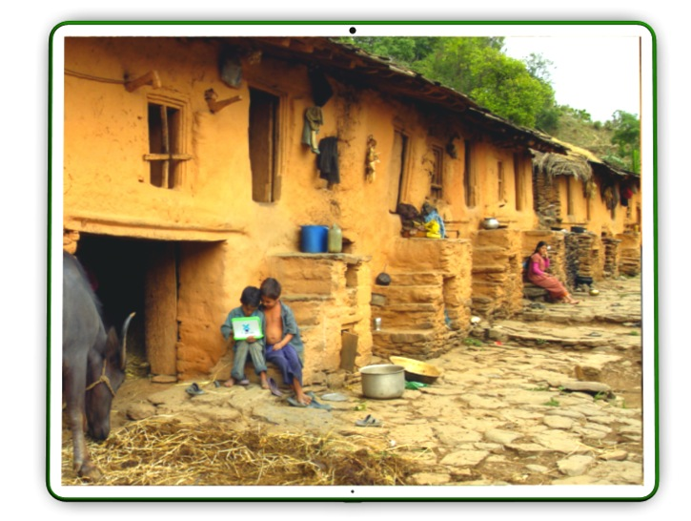
XO Tablet – Top and End View
COVER CONTACT
SPEAKER PORTS
ON THE GO USB
AUDIO IN
USB
DC POWER INPUT
SPEAKER PORTS
COVER CONTACT
AUDIO OUT
HOME BUTTON

Slide 45
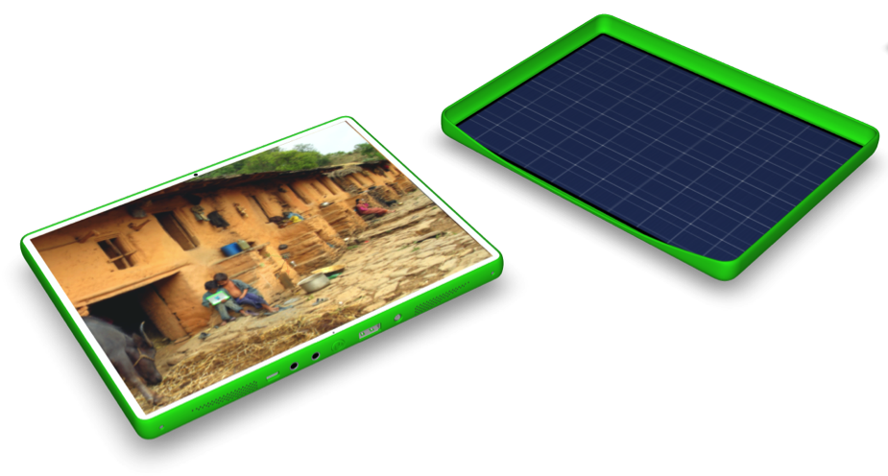
Solar Panel Cover – Detach and Charge
The Solar Panel Cover can be detached for easy charging outdoors or in a window.

Slide 46
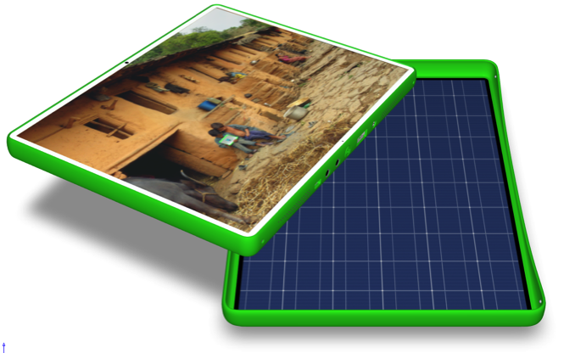
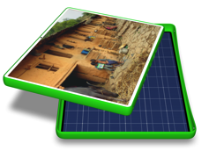
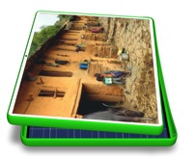
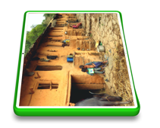
Solar Panel Cover – Docking Sequence
Raised contacts on the cover.
Slightly recessed contacts (could be screws) align with raised contacts on the cover.

Slide 47
Learning to Read
How the brain has evolved
Learning to read, to read to learning
Can children do it by themselves?

Slide 48
Costs
300 million children
$0.75 per week per child
$12 billion

Slide 49
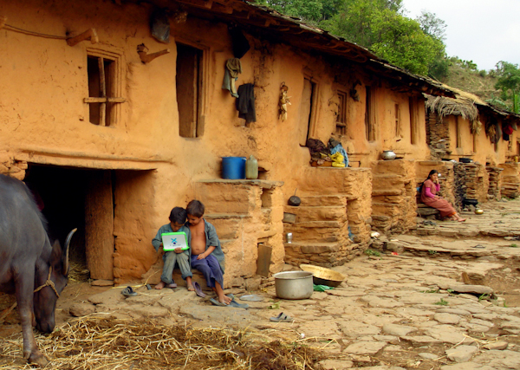

Slide 50
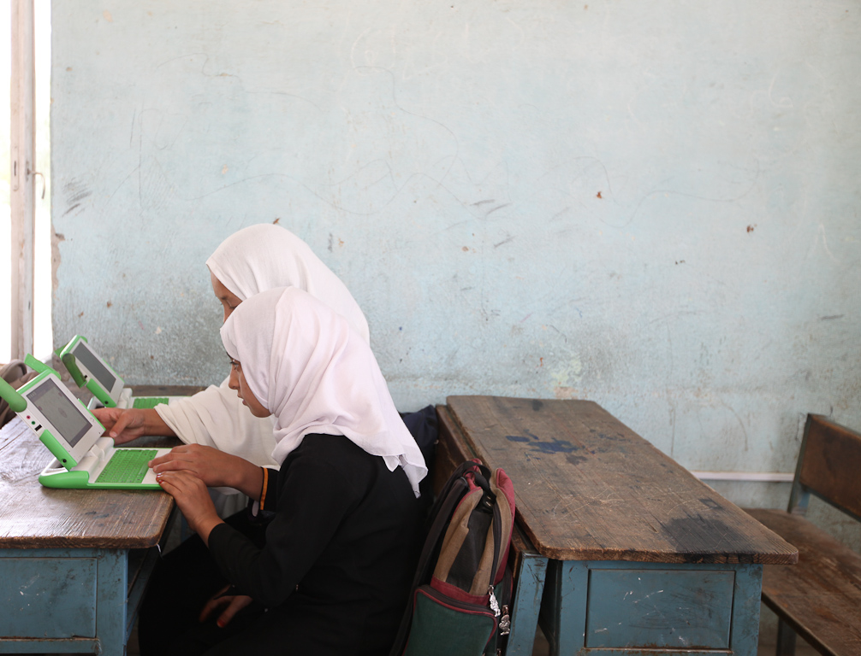

Slide 51
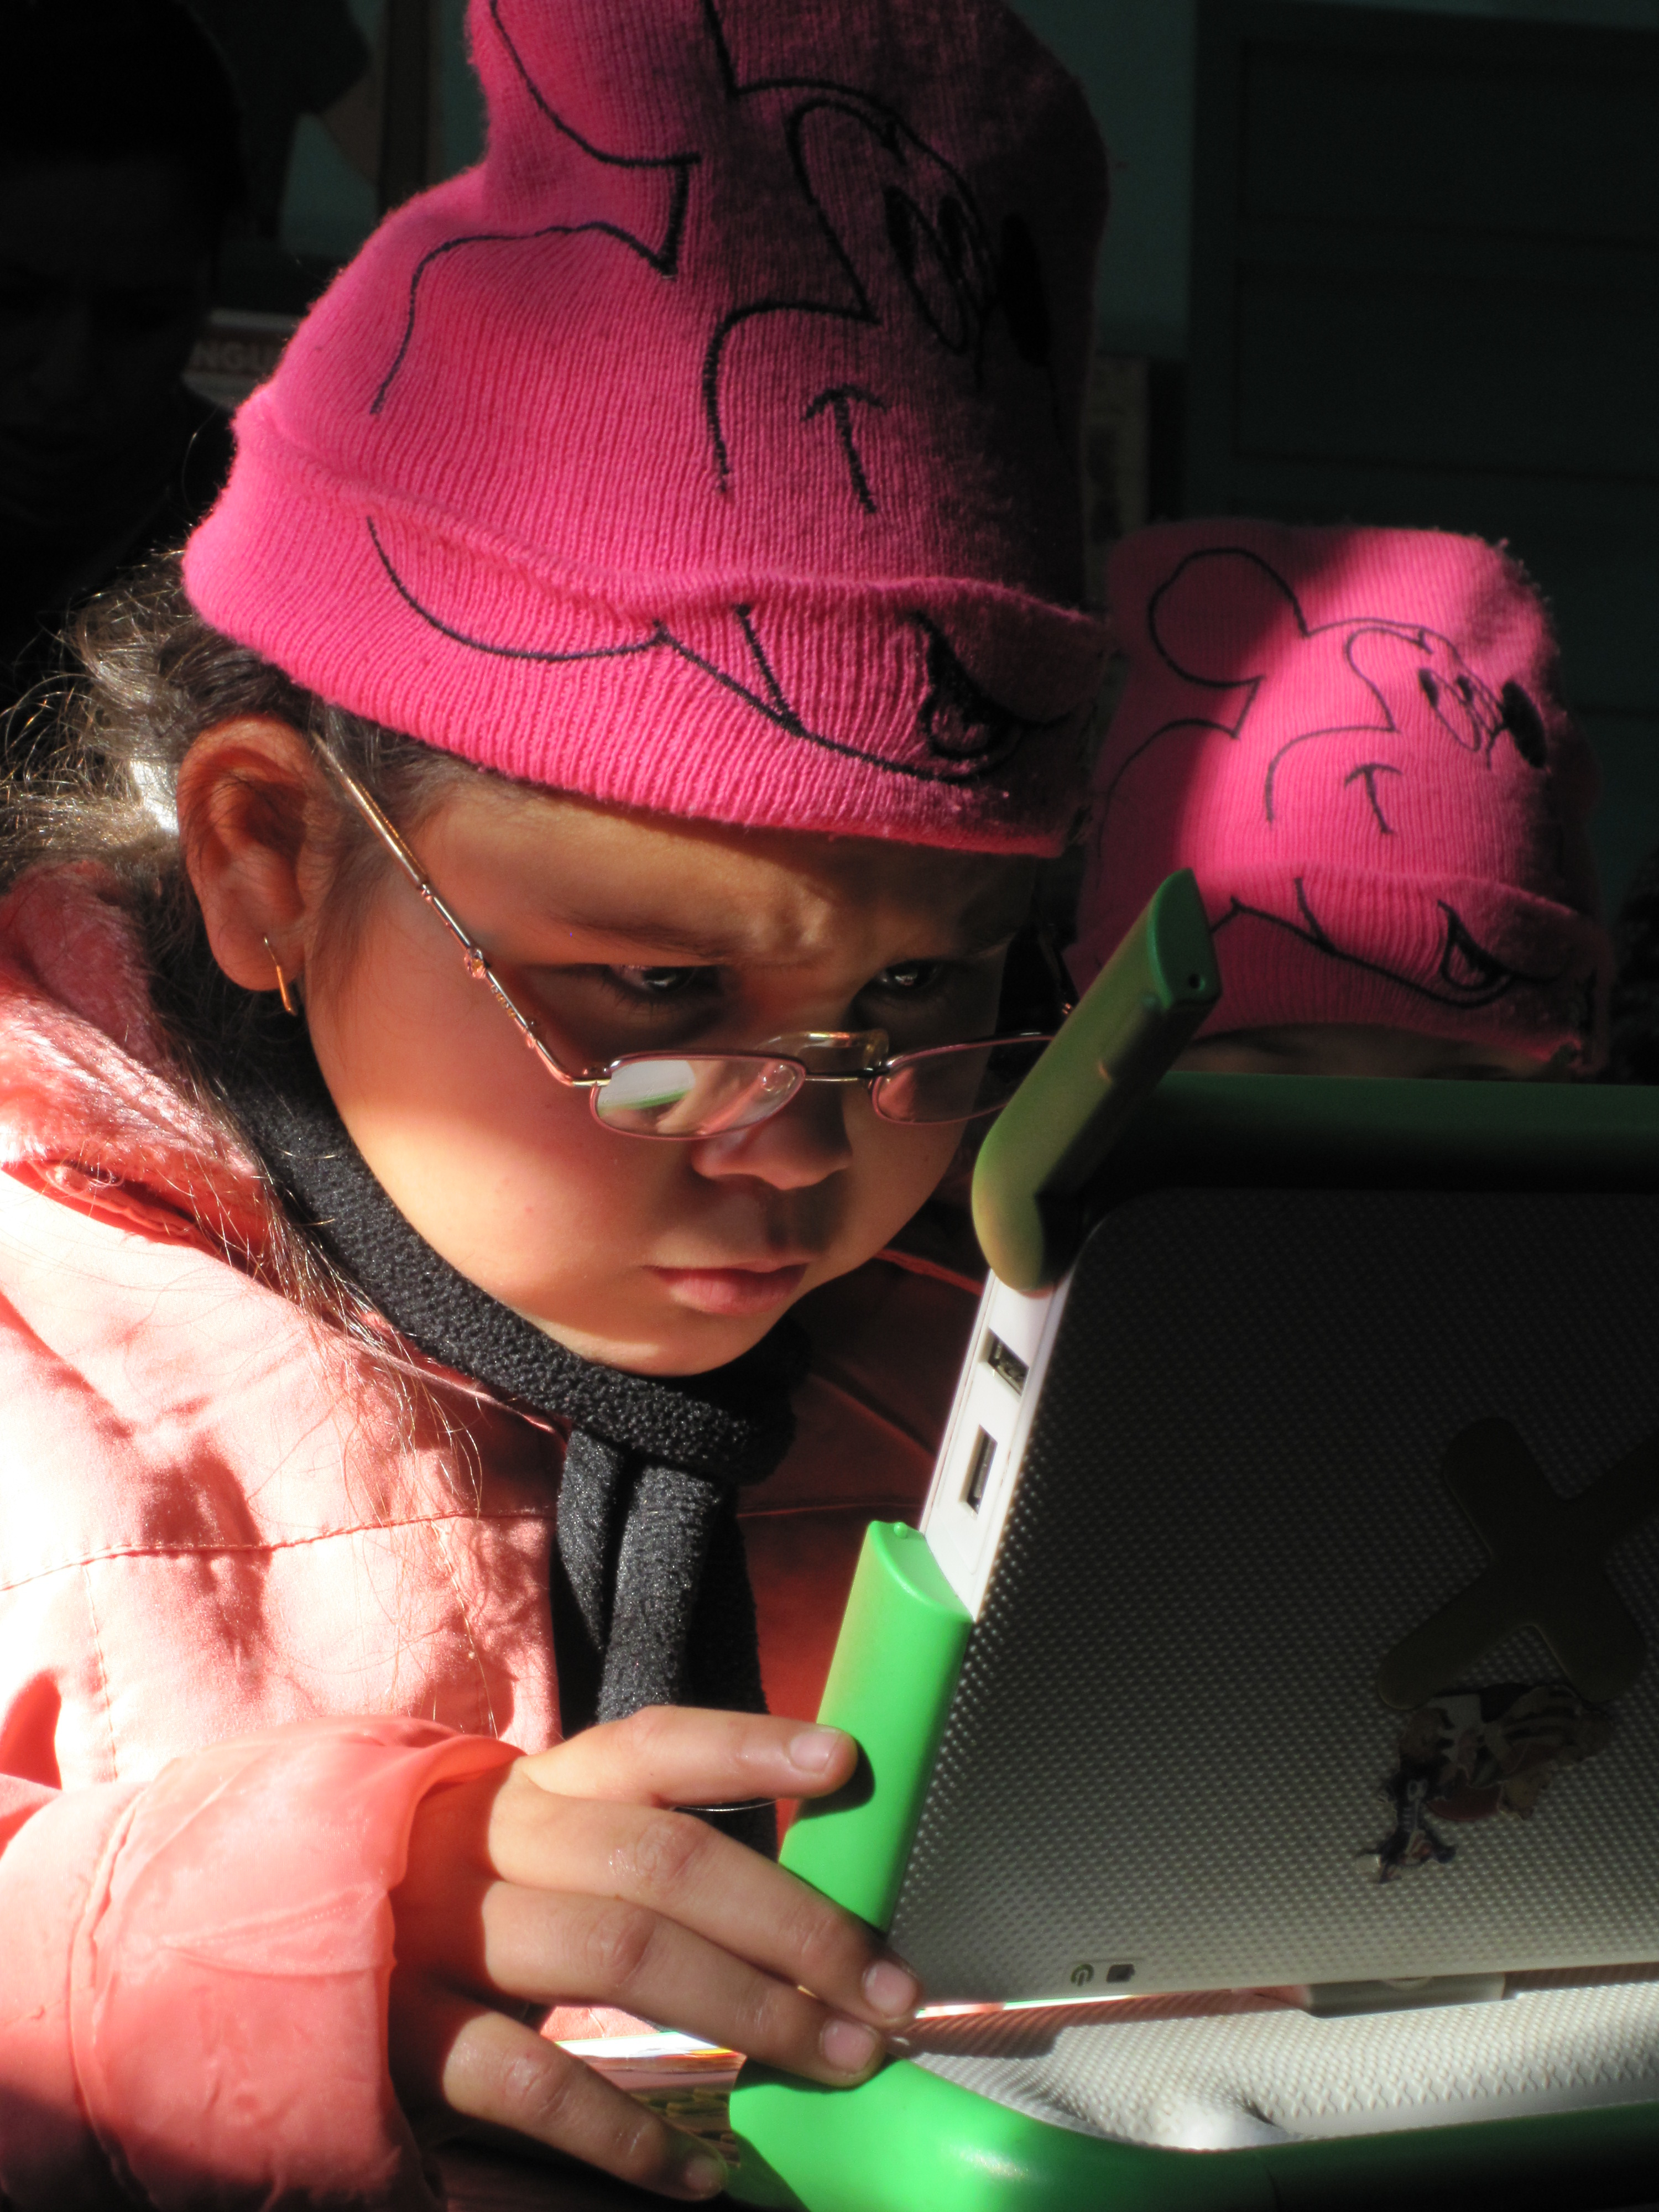

Slide 53
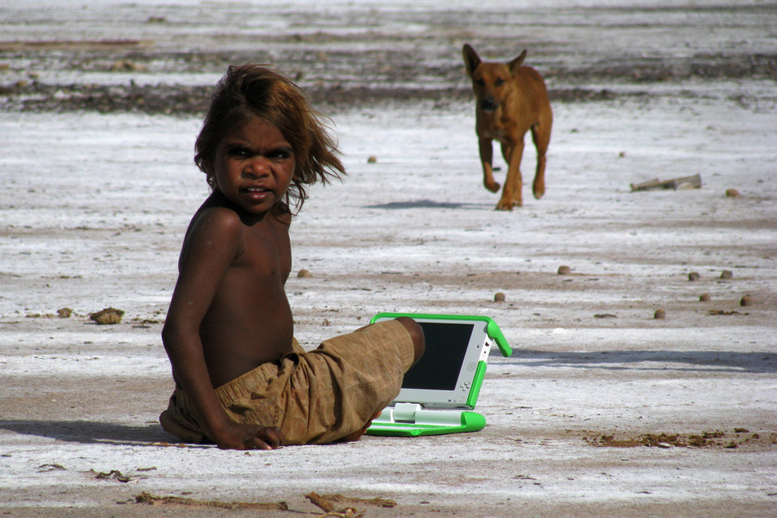

Slide 54
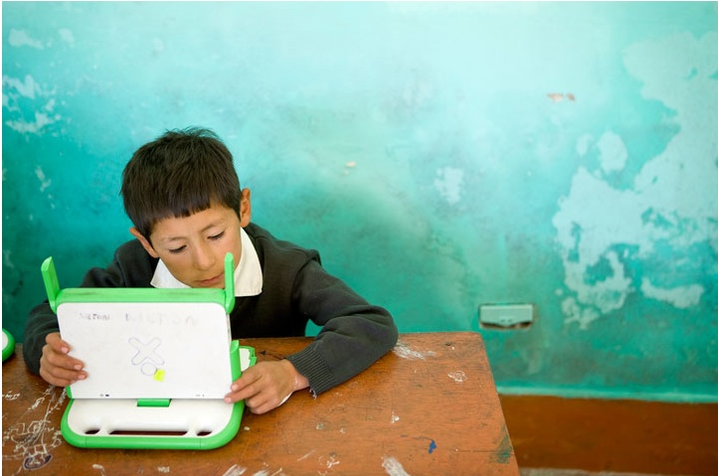

Slide 57
www.laptop.org

