Slide 1
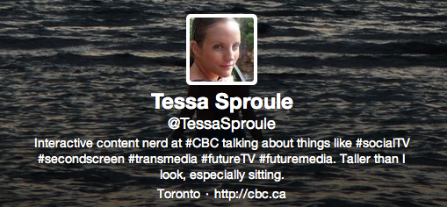
What’s the Internet for, anyway?
#MIT_CFP @TessaSproule

Slide 2
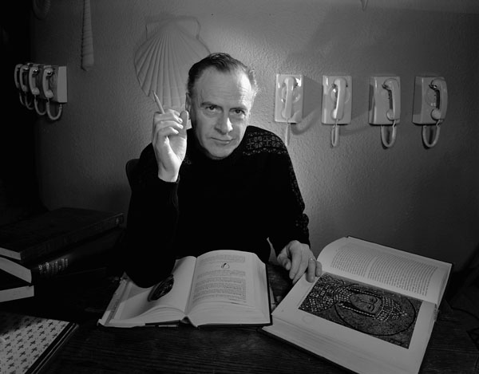
“The medium is the message.”
#MIT_CFP @TessaSproule
Notes:
Photo: Marshall McLuhan, January 21, 1967, photograph by Yousuf Karsh -- Library and Archives Canada.
"The medium is the message" is a phrase coined by Marshall McLuhan in his 1967 book, The Medium is the Massage. He meant that the form of a medium embeds itself in the message, creating a symbiotic relationship by which the medium influences how the message is perceived.

Slide 3
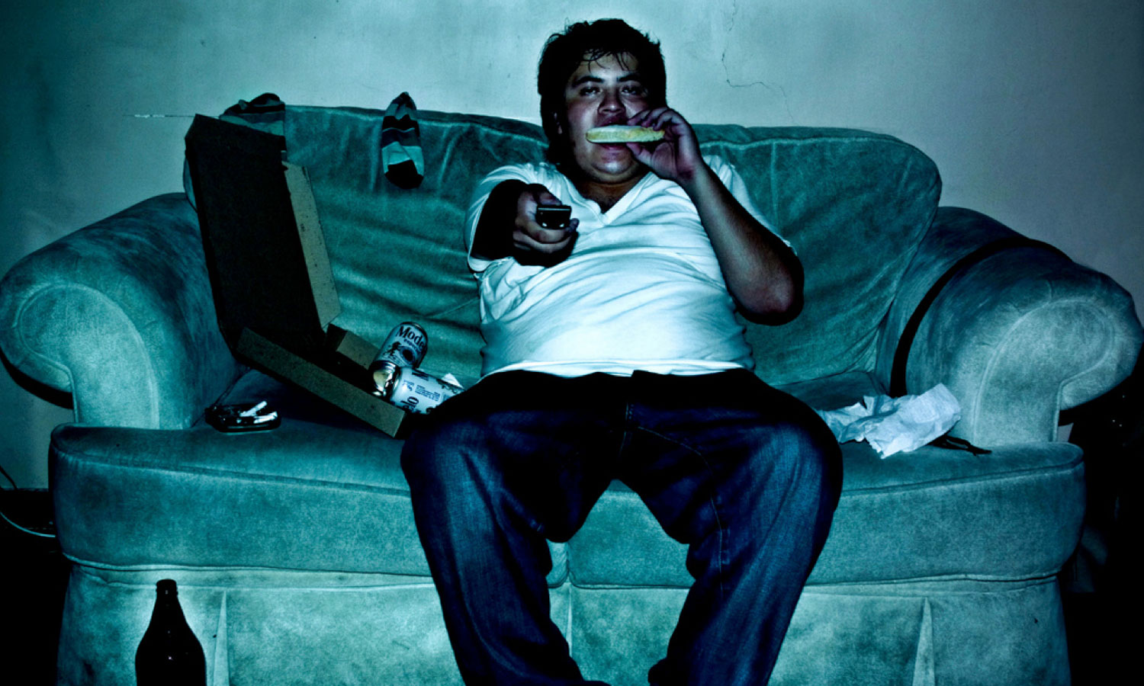
#ImWatchingTV
#MIT_CFP @TessaSproule
Notes:
Featured image courtesy of @alviseni licensed via Creative Commons. http://www.flickr.com/photos/alvi2047/with/3688993279/
I searched Flickr for “watching TV” creative commons pics….

Slide 4
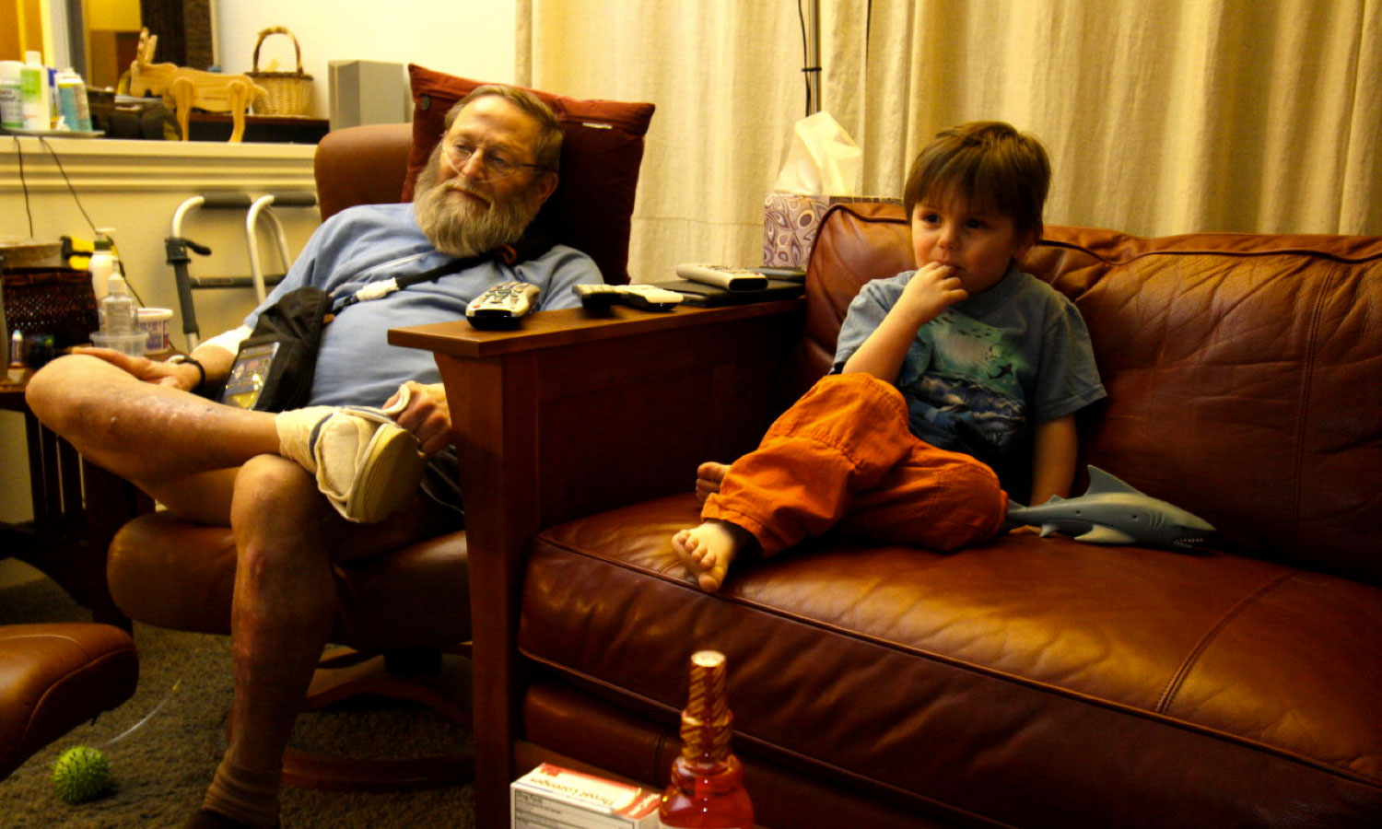
#ImWatchingTV
#MIT_CFP @TessaSproule
Notes:
Featured image courtesy of sean dreilingerlicensed via Creative Commons. http://www.flickr.com/photos/seandreilinger/4396101624

Slide 5
Back to this guy…
#MIT_CFP @TessaSproule
Couch potating is the gerund of the verb "to couch potato".
Alors: couch potating que es gerundio!
---------------------------------------------------------------
Just outta fun... in fact, I barely watch T.V.
Notes:
Back to this guy, whose Flickr profile says he did this photo recreation as a lark. He doesn’t even have cable.
Featured image courtesy of @alviseni licensed via Creative Commons. http://www.flickr.com/photos/alvi2047/with/3688993279/

Slide 6
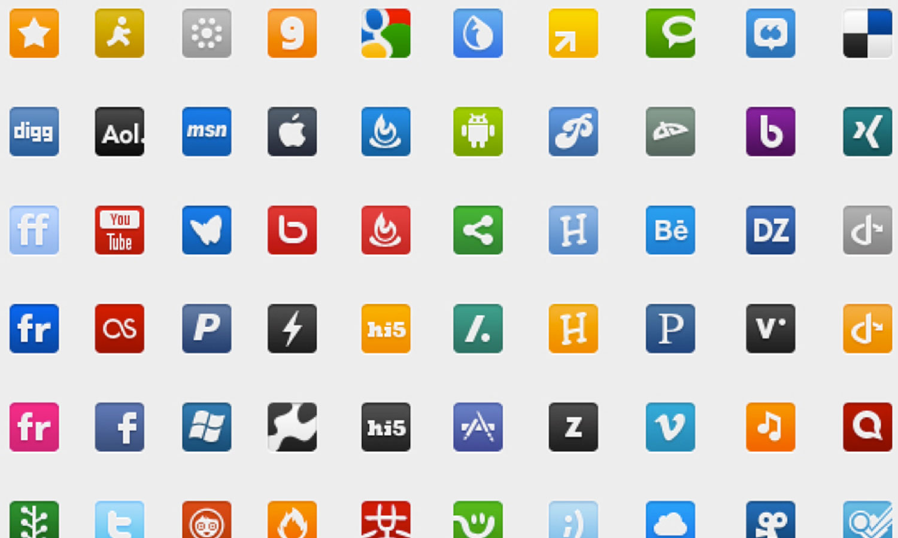
Whose network is it, anyway?
#MIT_CFP @TessaSproule
Notes:
Featured image courtesy of audreywatters licensed via Creative Commons http://www.flickr.com/photos/surreal_badger/8292958066/

Slide 7
The audience is the network.
#MIT_CFP @TessaSproule

Slide 8
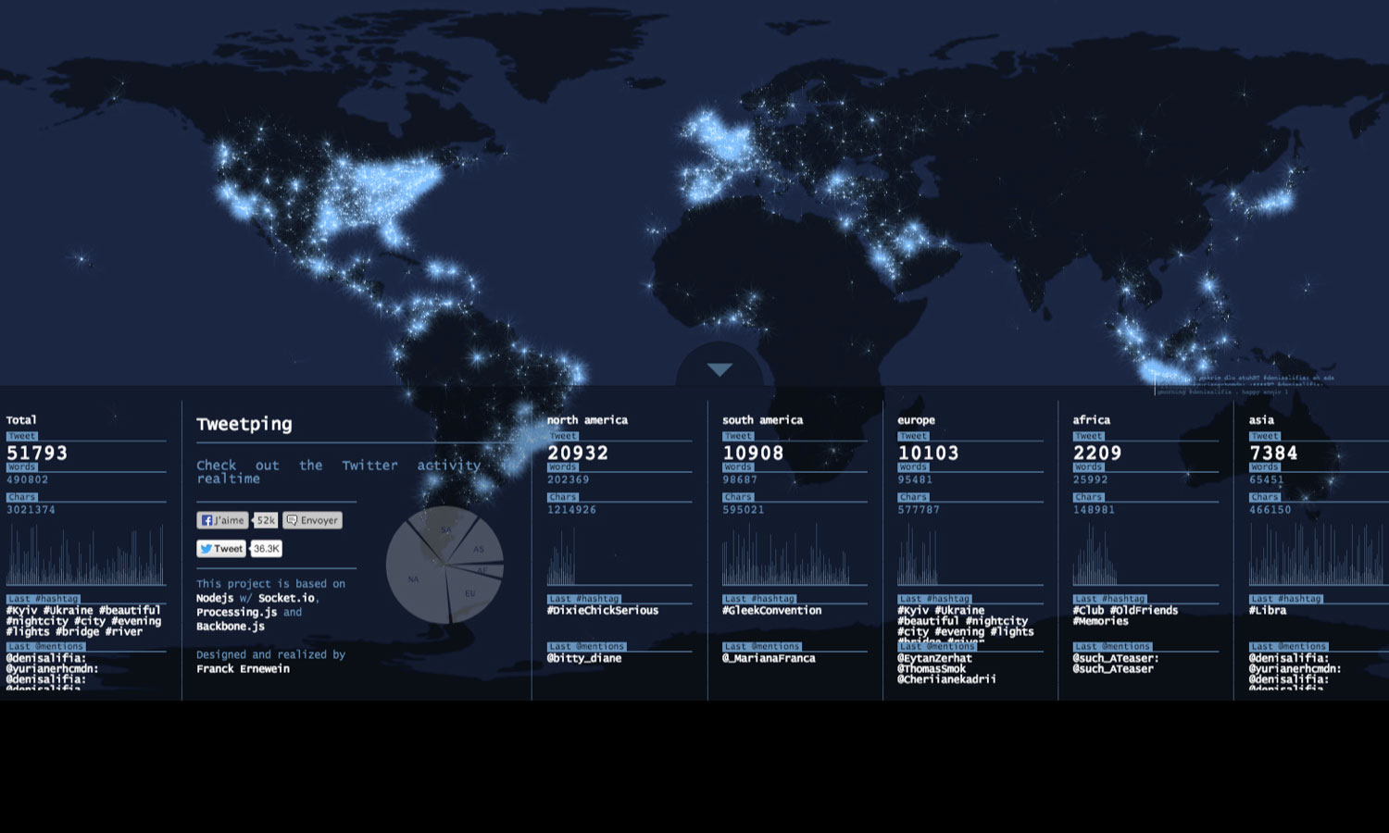
#TheAudienceIsTheMedium
#MIT_CFP @TessaSproule
Notes:
Image: Tweetping.com (20 minutes at approx. 6pm ET – 6:20pm ET)
http://tweetping.net/

Slide 9
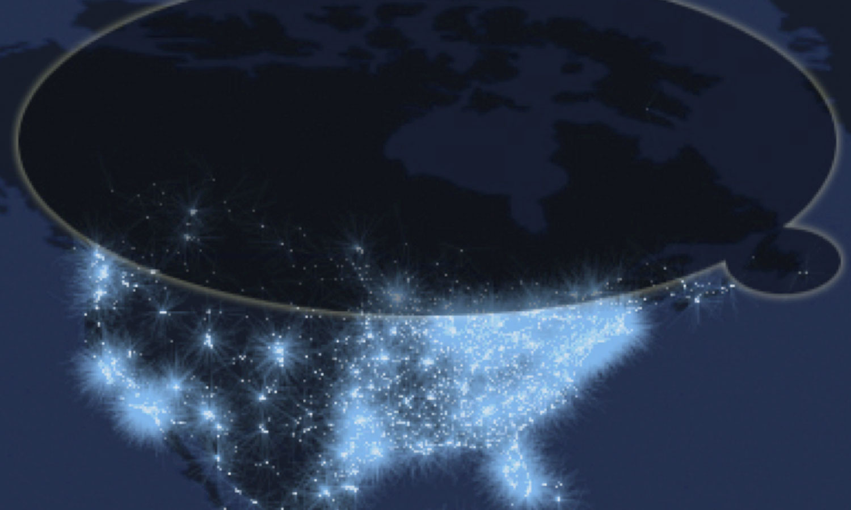
Can you hear a raindrop in a storm?
#MIT_CFP @TessaSproule
Notes:
Image: Tweetping.com (20 minutes at approx. 6pm ET – 6:20pm ET)
http://tweetping.net/

Slide 10
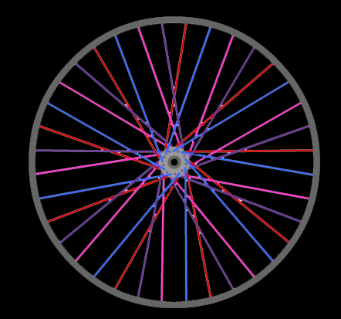
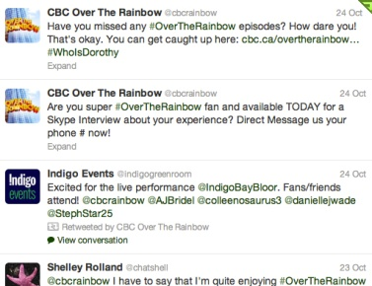
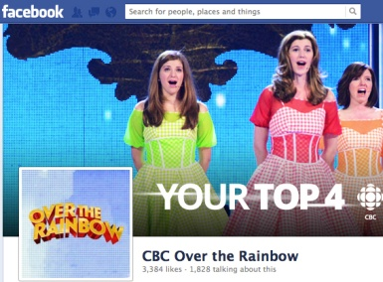
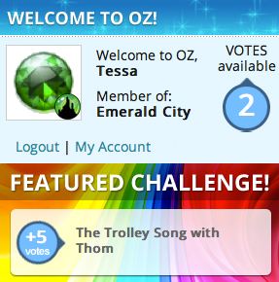
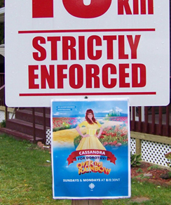
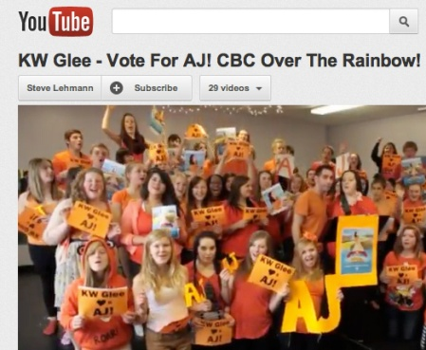
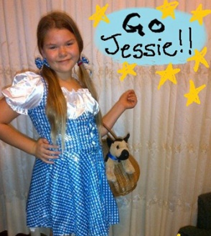
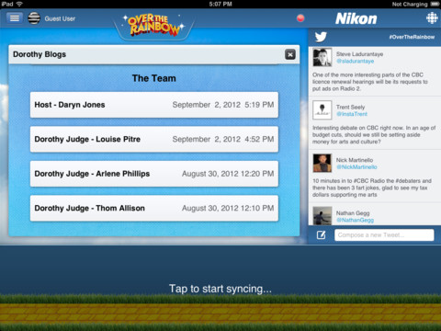
It’s the audience’s story…
#MIT_CFP @TessaSproule

Slide 11
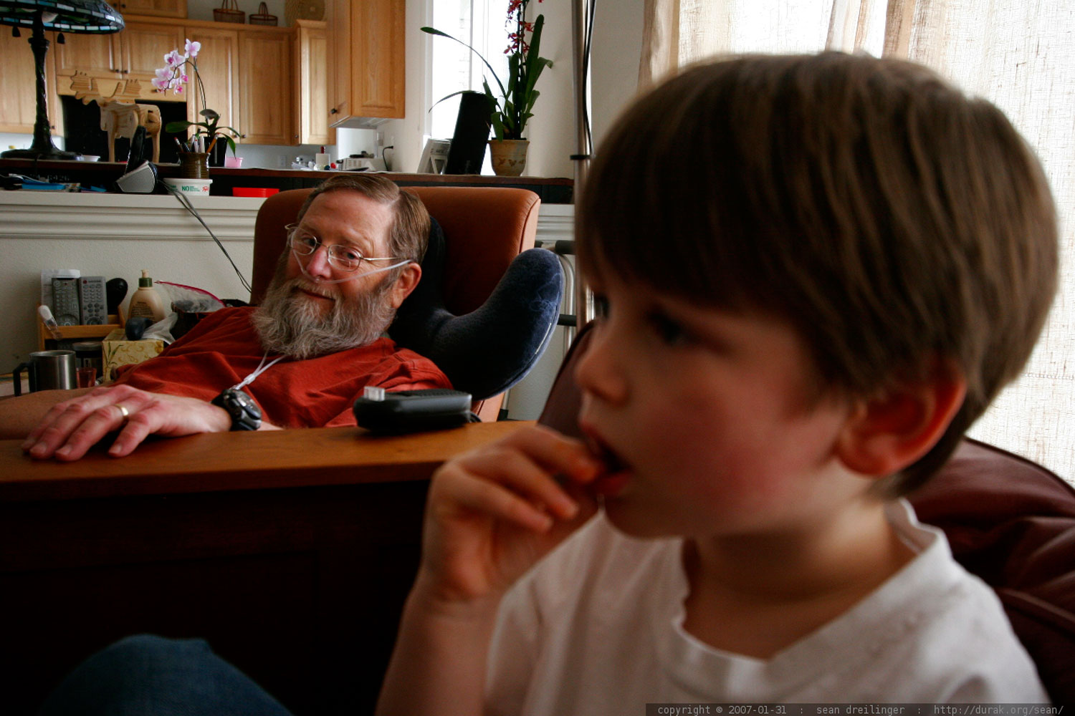
The audience is the medium.
#MIT_CFP @TessaSproule
Notes:
Featured image courtesy of sean dreilingerlicensed via Creative Commons:http://www.flickr.com/photos/seandreilinger/376059062/

Slide 12
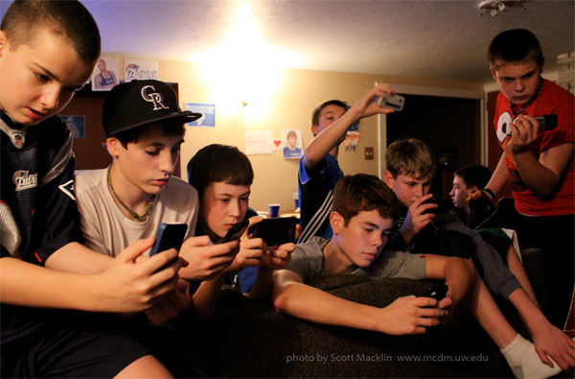
…But that might be a problem.
#MIT_CFP @TessaSproule
Notes:
Photo courtesy of Scott Macklin, associate director at the MCDM program at the University of Washington. This is a photo of his son, Case, and his friends watching Super Bowl 2012.

Slide 13
Thank you!
#MIT_CFP @TessaSproule

