Slide 1
The Ambiguity and Uncertainty of Disruption: Discovering the Future of Video Content
Natalie Klym
with Daniel Pereira

Slide 2
Disruption is confusing
Industry disruption vs experience disruption
New uses are ambiguous
Emerging markets are uncertain
So plan for learning and discovery vs execution
Notes:
Striving for legitimacy…

Slide 3
The future of video content?
“Video is exploding. It’s short-sighted to think that what we watch is going to remain stable.”
“Online video was born of the computing and Internet industry and culture, a decade before Netflix started streaming and long before YouTube existed.”
“New media and interactive CD-ROMS were different. They failed. Big media companies made that sh*t up. YouTube and Twitch—that’s pure user-driven innovation. Twitch now generates more traffic than Hulu.”
“Who cares about HBOGo, or HBO a la carte, or HBO on the moon! If you want to know the future of video, look at YouTube, look at Twitch. Netflix is just cable TV over a different pipe to a wider range of devices.”
“You don’t want to inherit the legacy of TV.”

Slide 4
The original research questions (2010)
The content divide: Most of the high-quality, “premium” (e.g., HBO, live sports) content is locked in the incumbent ecosystem.
The assumption was that you needed high-quality, premium content to compete. The early cord cutters were going back to cable.
How will the content landscape change?
What are the implications regarding disruption dynamics?
Production
Distribution
Premium
content
MVPDs
(cable, satellite, telco)
Incumbents
Online video
OVDs
(YouTube, Netflix, the Web…)
Entrants
Notes:
.

Slide 5
A framework: Quality vs Innovation
The heart of disruption dynamics
Quality: improvements on existing product attributes based on the traditional technology
Innovation: the introduction of new product attributes based on the new technology
The classic disruption story: The entrants’ early products are typically lower in quality but have new attributes that are valuable to the new customers.
Quality
Performance
Innovation
Time

Slide 6
A framework: Quality vs Innovation
How will the content landscape change?
What are the implications re disruption dynamics?
Production
Distribution
High-Quality
content
MVPDs
Incumbents
Innovative & low-quality content
OVDs
Entrants
Notes:
.

Slide 7
A framework: The symbiotic relationship between content and conduit
There’s a complex (and continuous) interplay between the characteristics of the conduit* and the content that is distributed
Conduit = networks + devices (Latin root means “to bring together”)
Content
Conduit
Attributes?
Performance metrics?
Properties?
Technology
Business models
Economics
Behavioral/cultural

Slide 8
Historical context
Online video represents the third wave of programming
Mass appeal
Conventional
Brand-safe
30-60 minutes
Niche appeal
Edgy, risky subject matter and style
Hyper-niche appeal
Hyper-edgy, risky
Authentic, engaging
Social
User-generated
Semi-pro
Unconventional narrative structures
Multiple formats (short-continuous)
NETWORK TV
CABLE TV
ONLINE VIDEO

Slide 9
The shift from network to cable TV
As cable TV matured
Quality improved
Higher production values (budgets)
Higher ratings
Higher number of awards
Quantity and diversity of titles
It became more innovative
More channel capacity → fragmented audiences
Less restricted by “decency” regulations and less reliance on ad dollars (pay TV channels) → more creative freedom → attracts creative talent → film/tv hierarchy reverses (TV as the new novel)

Slide 10
The shift from network to cable TV
Demand for network television declined
Percentage of households watching broadcast networks
90% − 1980
65% − 1990
58% − 2000
46% − 2005
…almost 50% since 1980

Slide 11
The shift from cable TV to online video?
The original research questions (2010)
The content divide: Most of the high-quality, “premium” (e.g., HBO, live sports) content is locked in the incumbent ecosystem.
The assumption was that you needed high-quality, premium content to compete. The early cord cutters were going back to cable.
How will the content landscape change?
What are the implications regarding disruption dynamics?

Slide 12
The shift from cable TV to online video?
More traditional “premium” content is entering the online ecosystem
The quality (and quantity) of native online content is increasing
There is increasing demand for innovative content

Slide 13
Traditional “premium” content is entering the online ecosystem
Netflix to become "the exclusive U.S. subscription television service" for Disney's new releases starting in 2016 (outbid Starz)
HBO/Amazon Instant Video deal for shows that are more than three years old and not limited by syndication deals on cable (i.e. Sex and the City, Entourage and Curb Your Enthusiasm.
Seinfeld (Sony)/Netflix: Talks are ongoing for Seinfeld to be made available on Netflix, which would mark the arrival of the show with the most profitable syndication deal in “traditional” TV history.
Weinstein Company/Netflix: The deal, struck in 2013, gives Netflix the rights to show all movies released by Weinstein Co. and its subsidiary, Dimension Films, before they appear on pay-TV channels.
Notes:
.

Slide 14
The quality (& quantity) of native online content is increasing
As of Q314, Total long-term budget for original content production (YouTube, Netflix, Hulu, Amazon Prime) = $1.85B
$1.1B for original programming in 2013. House of Cards launched in 2012, starring and directed by A-List Hollywood talent and met with audience and critical success.
$100M Investment in “channels” – niche original programming based on a curation model. YouTube stars are more popular than Hollywood celebrities among U.S. teenagers. (Disney bought Maker Studios for $950M in 2014.)
With a $500M content budget in 2012, Hulu initially focused on original documentary series. In January 2012, first original script-based series is announced – the 13-episode “Battleground.”
Q314, $100M budget for original programming – up significantly from Q214. Six full series put into production in the spring of 2014. Ten pilots are also in the works.
July 2014, Microsoft announces the closure of the Xbox Entertainment Studios. Original programming will no longer be in development for the Xbox gaming platform.
Notes:
The market is real…

Slide 15
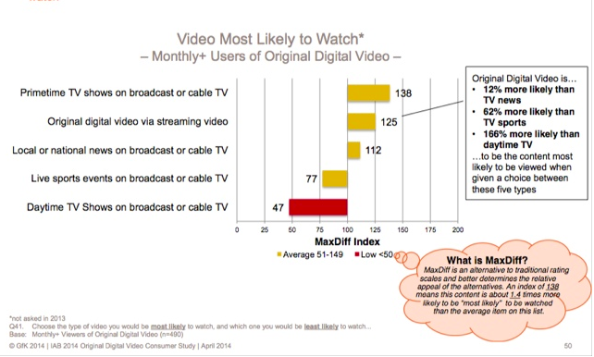
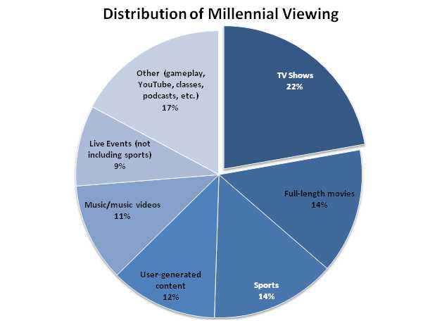
Increasing demand for innovative content
Especially among Millennials
The top reasons for watching online originals
ability to watch on own schedule (41%)
getting drawn in after clicking on a link (27%)
content is not available on TV (25%)

Slide 16
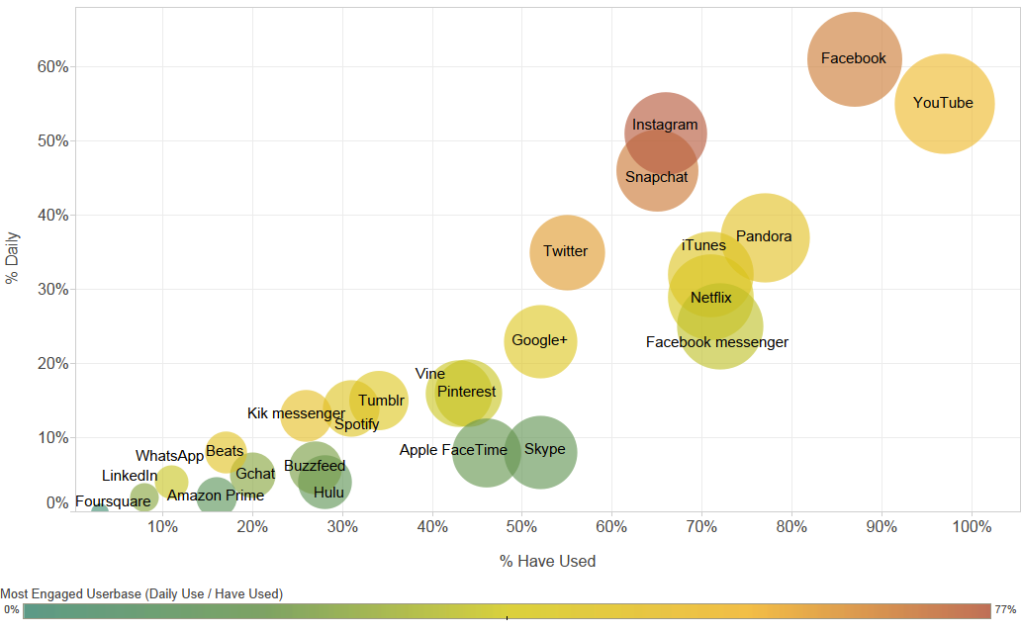
Increasing demand for innovative content
Notes:
More data…

Slide 17
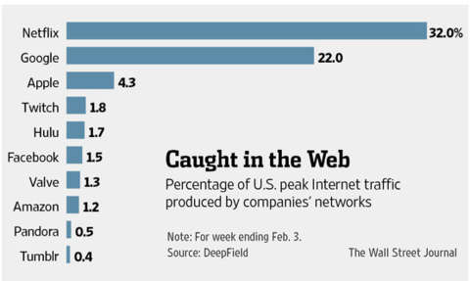
Increasing demand for innovative content
Twitch TV is 4th in U.S. peak traffic (February 2014)
“live-streaming” of video games with commentary
A spin off of Justin.TV, bought by Amazon August 2014
“a service so inexplicable that it left an entire room of middle-aged video streaming professionals shaking their heads… makes YouTube look like a dinosaur… provides a cautionary tale of what happens outside the paywall”
Notes:
A special case…
a “live-streaming” broadcast network for watching (not playing) video gaming
PewDiePie: “a weird mix of Bobby Fischer, Howard Cosell, Kim Kardashian, Jimmy Fallon”

Slide 18
Increasing demand for innovative content
YouTube stars are more popular than Hollywood celebrities among U.S. teenagers
A new type of media star: more engaging, extraordinary, relatable, authentic, intimate, candid, raw
Notes:
http://www.vulture.com/2014/05/google-and-twitch-tv-video-game-live-streaming.html

Slide 19
The shift from cable TV to online video?
The landscape is looking more like this… (who’s competing with whom?)
Production
Distribution
Quality (high to low) content
MVPDs
Incumbents
Quality (high to low) content
Netflix
Amazon
Hulu
Entrants
Innovative content
YouTube
Twitch TV
Twitter vines

Slide 20
Online revenues
YouTube generated around $3.5 billion in revenue in 2013. YouTube is predicted to generate $5.9 billion in revenue in 2014, and grow to $6.9 billion by 2016.
In Q214, subscription revenue totaled $1.146B - surpassing rival HBO for the very first time.
Hulu reached $1 billion in revenue in 2013 (up from $695 million in 2012).
In August 2014, Amazon acquired Twitch for $1.1B. (Google had previously announced that they would be acquiring Twitch for $1B.)
In Q114, revenue was up 23% on tripling in Prime Video usage.

Slide 21
Online viewership
More than 1 billion unique users visit YouTube each month
100 hours of video are uploaded to YouTube every minute
80% of YouTube traffic comes from outside the US
33M subscribers in the U.S. and 50.05 worldwide. Ranked highest in U.S. peak traffic.
Reached 5 million subscriber mark in 2013.
Twitch has more than 50 million monthly active users. In June 2011, Twitch had just 3.2 million monthly active users.
More than 1.1 million members broadcast videos each month.
More than 13 billion minutes of video are watched per month on Twitch.
In 2013, 10 Million subscribers – a doubling in less than two years. Predicted to double again in 2017.

Slide 22
Summary
There is a (often unqualified) perceived difference between “quality” and “innovative” content from the perspective of the players in the ecosystem including users, advertisers, content creators, producers, distributors, and ISPs.
This distinction has implications regarding competitive dynamics in terms of
viewer preferences
advertiser preferences
production and distribution strategies for content producers
strategic partnerships between ISPs and online distributors
Behaviors depend on the extent to which new and old media are perceived as complements vs substitutes

Slide 23
A few conclusions
Online video is still struggling for legitimacy—but getting closer
Online video is still disorganized and ill-defined: “We don’t have stable ‘buckets’ or ‘funnels’ for it. We don’t know what it means in terms of cultural currency or where it fits in the larger industry ecosystem, not yet.”
Different content categories (entertainment, news, sports) are experiencing disruption in different ways, at different rates
E. Zuckerman will talk about future of news later this afternoon
Notes:
First two bullets are summary… delete…
Despite growth…
Striving for legitimacy.

Slide 24
Discussion—your perceptions?
How would you describe your viewing habits & preferences in terms of quality vs innovation?

Slide 25
Discussion – Mobile video
Video consumption on mobile devices is up
Mobile was the fastest-growing platform for video viewership last year
Most of it is short-form
Will mobile disrupt Brazil’s telenovelas, or will telenovelas adapt to the new experience?
Netflix and Amazon have started offering shorts for mobile viewers…
Who wants to watch “shorts” on Netflix?

Slide 26
Discussion—Advertising dollars
Corporate inertia: Innovative content is popular among the most-sought after demographic, yet:
Advertisers don’t recognize “online video” as legit
Advertisers find it too time-consuming or mind-boggling to buy digital media.
Advertisers don’t want their messaging showing up against controversial or low-quality content
Mobile ad spend?
$19B by end of 2014 (U.S)
Facebook Q2 mobile ad sales grew by 34%, predicted to reach $6B in 2014
Newfronts (Digital media’s answer to the Upfronts)
Legitimize new content, attract traditional TV buyers
“shine a light on the content hiding in plain sight”

Slide 28
The shift from cable TV to online video?
Broadcast networks
$42B ad revenue 2013
$5B retrans fees 2013
Cable TV networks
$35B sub revenues 2013
$40.1B ad revenue 2013
Quality (high to low) content
MVPDs
$75B sub revenues 2013 (cable, satellite, telco combined)
Quality (high to low) content
Netflix
Amazon
Hulu
$1.146B sub revenue Q214
Innovative content
YouTube
Twitch TV
Twitter vines
$1B in revenue in 2013.
$3.5 billion in ad revenue in 2013. Predicted to generate $5.9 B in 2014, $6.9 B by 2016.

