Slide 1
Broadband on the cheap: why the French get it all for Free
Marie-José Montpetit, Ph.D.

Slide 2
Acknowledgements
Professor Gilles Laurent, Télécom-Paris University
Professor Jean-Pierre Chamoux, Paris-Descartes University
François Bélorgey, Patrice Slupowsky and Morgan Bouchet, FT/Orange
David Clark, Chintan Vaishnav and Bill Lehr, MIT

Slide 3
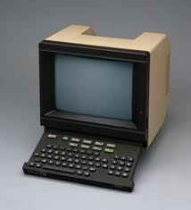
Legacy
In the 70’s France had the lowest phone penetration
Led to a major government led infrastructure initiative
80’s-90’s: Minitel
Started in 1982
Inexpensive
Always “on”
Not just directory but useful services
Schedules, tickets, reservations, weather, news
Delayed the Internet penetration
90’s opening the local access
00s services competition
Notes:
70s: local café or post-office for calls
Minitel: Rose service very successful… Minitel ended in June 2012!
Minitel: services similar to initial TV widgets

Slide 4
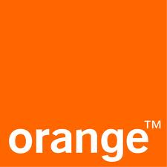
The Original Players
France Telecom
The legacy monopoly operator started with PTT (Poste, Télégraphe et Téléphone)in 1923
Separated from the Post in 1991
Still 14% state owned
Full tate ownership ended in 2004
The PDG (CEO) is named by the government
Pension/bureaucratic legacy (and change is hard)
Now Orange
Wired/wireless merger
Société Française de Radiotéléphone (SFR)
Started as radio-telephony in 1987
Bought Neuf-Cegetel to create an alternative to FT
100% owned by Vivendi
Bouygues Telecom
Part of a huge industrial/construction conglomerate that dates back 150 years
Notes:
SFR: cell network built by Vodaphone
Vivendi was known as Vivendi Universal

Slide 5
Will Unbundling creates Service competition?
Notes:
Mention Chintan’s work

Slide 6
European Union Mandates
The EU mandated opening the local loop by 1998:
Opening the EU market to competition and lower costs for the “Information Society”
Defining rules and tariffs to support competitor’s equipment in control centers
Supply aspects: equipment not manufactured in Europe, fear of capital movements out of the EU
Each EU member can interpret these mandates differently
In France, regulations started in 1991, took effect in 1997

Slide 7
Opening the Local Loop in France
Tariffs: Imposed by the regulator
Professor Gilles Laurent of Télécom-Paris helped define the 2000 prices that were used to open the market (Forward-looking long-run incremental cost, LRIC)
Competition: mainly ADSL
While the cable infrastructure was also built by the government, it was not greatly adopted (Numéricable’s offering is limited)
Differentiation: ancillary services
Criticism: from the legacy operator
“who lose the control of the network loses the control of the service innovation” (François Bélorgey - Orange)
Collusion: the operators fight back
In 2005 the 3 main French operators were found guilty by the Conseil de la Concurrence for sharing confidential information between 1997 and 2003 (535 million € fine)
Notes:
Chintan’s work applies: competition on ancillary services
The cost of unbundling could have been established 1 ½ to 2 times higher if not for firm regulatory involvement
Tariffs were controlled until the 3rd party low-cost operator appeared

Slide 8
And then it became

Slide 9
An Entrepreneur in Telecoms
Il a Free, il a tout compris !http://www.ina.fr/histoire-et-conflits/decolonisation/video/I00012428/charles-de-gaulle-petite-phrase-je-vous-ai-compris.fr.html
Feel Free
La liberté n'a pas de prix
(Freedom has no price)
Incroyable mais Free
Pun on “incroyable mais vrai” – unbelievable but true
Notes:
Free is from Illiad – a communication entity – not a telecom operator
The founder comes from Minitel-Rose

Slide 10
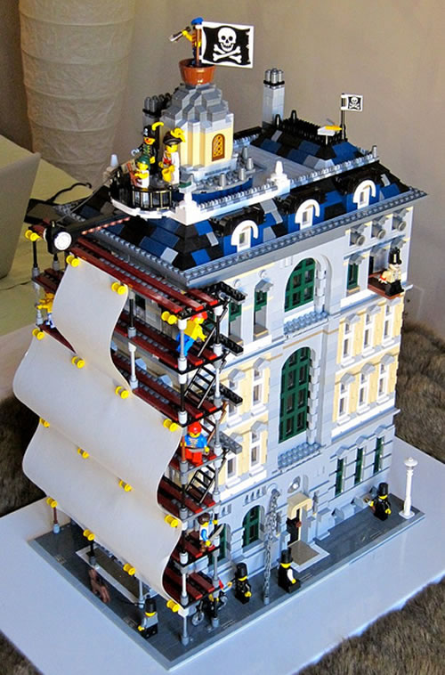
Notes:
A startup going after the telecom giants (thanks to Monty Python’s Crimson Permanent Assurance in “The Meaning of Life” and hopefully not falling off the edge of the world)

Slide 11
But this is NOT a Pirate Story
Free is owned by Illiad, a communications group
Not predatory, they seek profit
They profit from the low unbundling costs of 8,5€ per month per line for ADSL (effective 2012)
Free started in 1999 as a “free” email service with no subscription
“Free” now refers to the absence of contracts
ADSL offering in 2002
TV and illimited voice added in 2003
Innovative approaches
The initiator of the “box”
Freebox: single box for all services (Freebox Revolution – 2nd generation)
Low opex
Takes user behavior into account
Notes:
Access costs - source ARCEP
Other unbundling costs per line per month cited at 7 euros
Single box reduces operation costs
User behavior: less than 30 minutes cell talk – most within a single cell – install Free cells in villages roam over Orange outside

Slide 12
Some Free Statistics
Flat 29,99€ per month with Freebox Revolution
(FTTH adds 10€)
Add 1,99€ for 197 TV channels and 4,99€ for multiscreen
28 Mbps on unbundled phone line/33 Mbps on their own lines
250 GB DVR included
802.11n
IPV6
Zero cost VoIP calls to 180 countries and to French mobiles
Add mobile for 15,95€
(19,95€ if you are not a Freebox customer)
Unlimited texting
Free mobile to mobile calls to France, Canada and US and to fixed numbers in 40 countries
3GB data
“Freewifi”
Each Freebox is a hot spot
Ancillary services
Premium channels packages available for 6,99€+ (mainly cinema and foreign language channels)
TV-Perso (your own TV channel), Bluray disk , Gaming (some free), browsing etc.
Application store
Notes:
Morgan Bouchet (Orange): French Channels not expensive, premium channels in a extra package
There is also a 0€/2€ package of 60 min/60 SMS in France only

Slide 13
Too Free to be True?
Freebox: hefty security deposit
400€
Prevents a grey market for the boxes
Reimbursed after 2 years
No contract but 49€ termination fee (24 months)
No family plans on mobile
No phone subsidies
They allow you to pay your iPhone is 2 installments!
Questionable level of support
10 hours on “working days”
But “improving” according to blogs
Accused of monopoly on some condo agreements
Their new mobile license has not been very successful

Slide 14
The “Balance of Terror” (Prof. Laurent)

Slide 15
A Quadrupoly
Capitalism at work: Free created a competitive market
All operators are profitable
Orange, SFR and Bouygues now offer similar boxes and packages with added services, more TV channels, games, premium customer service etc.
The low costs have expanded the broadband market
6 percentage points from 2005-2008
Ref. Princeton/ARCEP Study – 2008
Notes:
France is usually associated with out of control socialism but not it seems in the broadband market

Slide 16
Getting more Revenue
Operators are also looking at foreign operations:
Export the French know-how
FT/Orange in Poland in Asia
They have a larger proportion of retirees, legacy government employees et other historical costs so an incentive to look abroad for less regulated environments
SFR in La Réunion
Free in some US markets

Slide 17
Next Generation
Because the DSL is so good FFTH is slow to get market share in France
Consumers: why go above 30Mbps?
In FTTH, each company installs or buys it’s own infrastructure
Probably not the end of the quadrupoly
Notes:
FTTH about 60€/month – also all included

Slide 18
Conclusion
The French broadband market shows that competition works
Profited from a government paid infrastructure that moved the competition to the services
Will be interesting to see what will happen in the future
The next innovation?

Slide 19
Could this happen in the US?
An interesting discussion topic
Notes:
Dave Oran: use government funding for the “public good”

